Slide 1





LET’S TALK FINANCING
Notes:
Please feel free to remove the “cc by” licence logo and add your own branding. This toolkit is open licence so you can re-brand and use commercially, but please acknowledge the UK-South Africa Tech Hub and let Launch League know you are using the toolkit. We appreciate the feedback!

Slide 2





What is Launch League?
This methodology and toolkit that we will be using today was created by the British High Commision UK-South Africa Tech Hub Launch League project. The Launch League project creates resources, events and opportunities for South African hubs to improve programmes and services for entrepreneurs in their communities.
@uk-south-africa-tech-hub
@UKSATechHub
@uksouthafricatechhub
Notes:
Start your workshop with the entrepreneurs by giving them background and context on the Launch League program, with a mention to where the support comes from. They can also be directed to the Launch League website: https://launchleague.co.za/
It is part of the UK SA TECH HUB

Slide 3
About this toolkit
This toolkit will help you understand:
How to identify if a business needs finance
Ways of getting going without finance
Differences between an SMME and a startup
The key components of a business that are relevant for finance
What types of finance these components can attract (matrix)
What financiers want
Documentation that is needed to apply for funding
Notes:
This toolkit will help you understand:
How to identify if a business needs finance
Ways of getting going without finance
Differences between an SMME and a startup
The key components of a business that are relevant for finance
What types of finance these components can attract (matrix)
What financiers want
Documentation that is needed to apply for funding

Slide 4
DISCLAIMER
The toolkit does not give financial advice, instead it shows an entrepreneur what financing sources would be realistically available to them. Decisions about which type of financial products to use and when, is entirely at the discretion of the business owner, and it is important that they are aware of the risks, benefits and costs of each of the types of finance that exist.

Slide 5
Notes:
This quote is included to give context for entrepreneurs that getting your business ready for finance is an important way of making sure the business is sustainable and survives in the long term. You can host a discussion here on what a business needs to do to be ready for finance. Ask the entrepreneurs some of these questions: - What do you need to do to be ready for finance? - Have you received any finance in the past?
- What did you have to do to get that financing? - How can we make sure our business affairs are in order?

Slide 6




Important components for business financing
There are four areas that are important to unpack, in order to understand what financing options are available to an entrepreneur.
Stage of Business
Revenue & Business Model
Assets and Risk
Growth plans
Notes:
For each of the four stages listed here, have a brief overview of what the terms mean. You can allow space for questions.
Each section will include a deep dive, so do not get stuck here for too long

Slide 7
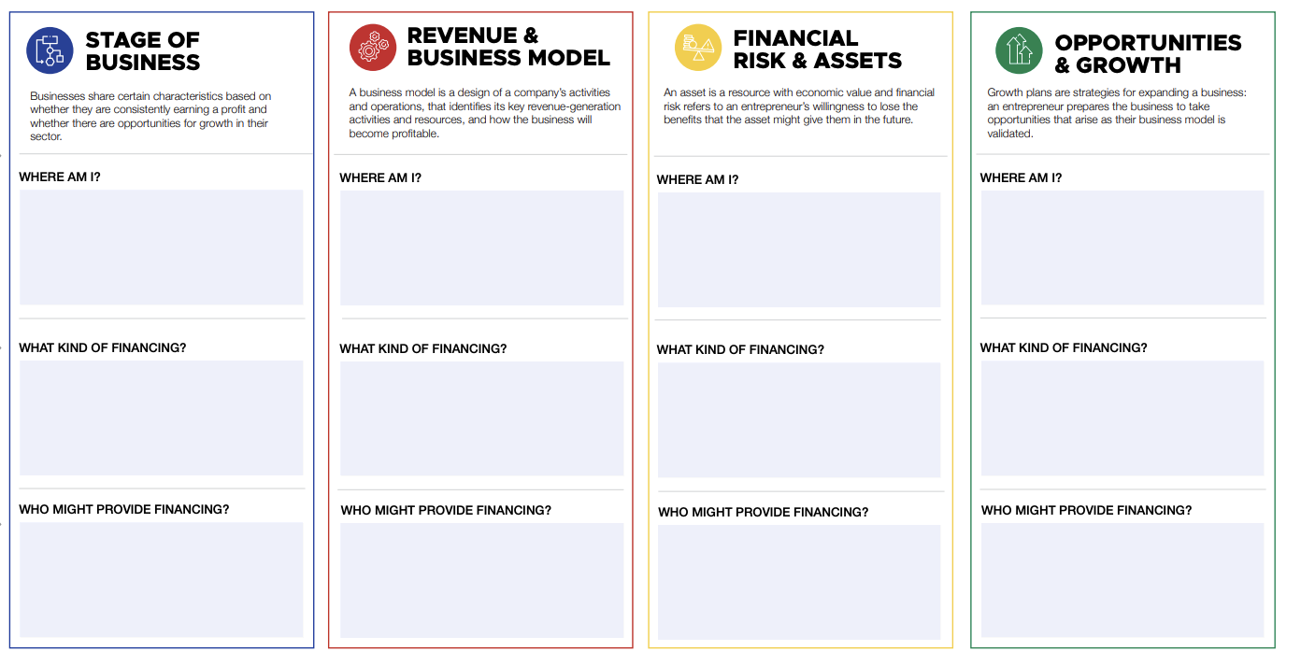
Entrepreneur financing card
The entrepreneur financing card is a profile of the business that contains the key information that is relevant to the types of finance that they would be able to qualify for. We will fill out the card below for BXL
Notes:
This is an opportunity for you to describe the entrepreneur funding card and how it will be used. “The entrepreneur funding card is designed to help you expand your understanding of the finance that might be available for your business. It is set out in four sections: stage of business, business model, assets & risk and growth plans. Start each section by going through flow charts on the next page and filling in your response in the top block. Use that response to see the types of finance available in the funding matrix and fill in the corresponding block. Lastly, use the funding database at https://cutt.ly/letstalkfinance to find funds that match the types of funding that are available.”

Slide 8
Part 1: Stage of Business

Slide 9
Why is the stage of a business important for financing?
The more established a business is, the less risky it is for an organization to provide financing for it, and the greater the chances of it receiving financing.
Revenue
Time
Notes:
To help an entrepreneur understand the type of finance that is available to them, we need them to be realistic about the stage of business that they are in.
Getting out of the “idea” phase is difficult, but the chances of getting finance are greater when there is a track record or they have proven that there is a market for what they are doing and customers are willing to pay them for their products and services.

Slide 10
[FLOW CHART 1]
Stage of Business
The type of financing that is available for a business is highly dependent on the stage of business. Use this flowchart to understand what stage of business the entrepreneur is in.
No
Has your business earned any money from a customer?
Yes
No
Is your business able to cover costs with the money it generates?
Yes
Has your business generated a profit in the past?
Yes
Do you plan to grow your business in the short to medium term?
No
Yes
No
Pre-trading /
Idea stage
Pre-profit
Established but stressed
Established and stable
Profitable and growing
‹#›
Launch League | Let’s Talk Financing!
Notes:
Go through the flow chart with each of the entrepreneurs. Make sure you give each entrepreneur a chance to talk about where they are in the flow chart and what this might mean for the type of financing available

Slide 11
[FUNDING MATRIX 1]
Stage of Business
The financing matrix below shows examples of the types of financing that are available for each stage of business.
 | INTERNAL |  | GRANTS |  | DEBT |  |  |  |  | INVESTMENT
STAGE | Bootstrap | Sales | Pre-launch events* | Gov/NGO funds** | Bank overdraft | Bank loan | SMME Finance | Secured loan | Gov loan | Family/ Friends | Incubator/ Accelerator | Angel Investor | Venture Capital
Idea
Pre-profit
Established (stressed)
Established (stable)
Profitable & growing
‹#›
Launch League | Let’s Talk Financing!
*Startup competitions and pitching events may provide some early financing to help kick off an idea, but they are often highly competitive ** Government or NGO grants exist but often involve a complex application process and can sometimes be restrictive in nature

Slide 12

Internally generated finance
Bootstrapping
This is a way of building a company using limited resources, usually just personal savings, until the business starts to generate revenue. Bootstrapping may also involve tapping into other non-financial resources around you.
If an entrepreneur is unable to access finance early on, it may be helpful for them to map the resources that they have available to them. They can think wider about how they might start their business without having large amounts of starting capital
Bartering
Some businesses get support from bartering, which means exchanging goods/services for other goods/services. No money changes hands when bartering, and it can be a useful way to get started
Customers
One of the ways to generate finances early is to focus on sales to your customers. Finding customers early on might be difficult, but there are some big advantages to having them:
Don’t take equity or want control
Invest in your business again and again through purchases
Will bring more customers to you
Want your business to succeed
Plentiful if you hit product market fit
Need less from the SMME to make an investment
Notes:
We want the entrepreneurs to understand that they can use internally generated finance to fuel their growth. This slide can be used in conjunction with the Stage of Business matrix

Slide 13
Non-financial and other support
In-kind services
If an entrepreneur is unable to access finance early on, there are often non-financial support mechanisms that are available. For example, in-kind services are sometimes made available by organizations to help out entrepreneurs, especially at an early stage.
In-kind services are services that are not paid for and are either donated or exchanged for other services.
Some organisations (such as SEDA in South Africa) have in-kind services such as business planning workshops, technical assistance or administrative support that can be as useful for a business as financing is
Preferential or deferred payment
One of the ways to help manage your finances in your business without taking on direct financial assistance is to arrange with suppliers or customers to change the payment terms to help the entrepreneur.
Deferred payments can be arranged with suppliers to allow a small business to pay at a later stage, usually once they have earned money from utilizing the supplies.
Preferential payment terms are arranged with customers, particularly on big contracts, where the entrepreneur is paid quicker than what they would normally be paid. This helps ease the pressure on cash flow and allows the use of this money for working capital

Slide 14
Family and friends
Raising money from family and friends
Who should you ask?
Before asking family or friends, understand who you have a good, healthy relationship with and whether this relationship is strong enough to involve in business. This is important to know, as asking for money can put pressure to place on the relationship. Also, consider their areas of expertise and their financial ability to assist.
How should you approach them?
When you approach a friend or family member, have an open discussion with them about the possibility of investing in your business. Once interest from their side is established, set up a meeting to discuss the pitch. Each pitch should be individualised and tailored to the person and how much they could reasonably afford to invest.
How much should you ask for?
Consider how much risk a person is willing to take on and tailor the amount for each investor: if you pitch to someone who doesn’t take big risks, asking for smaller amounts over a period of time, that are based on the performance of the business. You also need to decide whether you are going to give up equity, or take on a loan with negotiated repayment options.
Important things to remember
Your business dealings can put pressure on a friendship or family relationship. You need to make sure you manage the relationship and communicate well.
Do you want to solicit large amounts of money from a few people, or small amounts of money from many people?
Present a detailed schedule of your initial startup costs, working capital, operating expenses and income, projected over 6 months to a year.
Professionalism is key: a 5-page document detailing the key facts about the business’ operations and what you will apply the money toward, is necessary for the initial meeting. (This ensures that important disclosures about the business are made)
Formalise the terms of the financing received in a written contract with both parties’ signatures.
Discuss and write down contingency plans for the possibility of the business collapsing with the investor.
Continuously update the friends and family who have invested on the progress of the business, through regular emails or messages.

Slide 15
Part 2: Business Model

Slide 16
Why is the type of business model important for financing?
Business Model Definition
A business model is a company's plan for making a profit. It identifies the products or services the business will sell, the target market it has identified, and the expenses it anticipates.
The type of business model that a business uses affects all aspects of the business, such as the way they generate revenue, their cash flow requirements, the types of assets that they have available and the type of customer they deal with. All these components influence the type of financing that a business might have access to.
For example, if a business is involved in manufacturing, they are likely to need machinery and other assets to produce their products. In this case, they may be able to get asset finance to purchase the equipment or a special manufacturing loan from the government.
The flow diagram on the next page helps identify a few important
Notes:
For example, if a business is involved in manufacturing, they are likely to need machinery and other assets to produce their products. In this case, they may be able to get asset finance to purchase the equipment or a special manufacturing loan from the government.
The flow diagram on the next page helps identify a few types of business, and the matrix shows how the types of finance varies between them.

Slide 17
[FLOW CHART 2]
Revenue & Business Model
Select all red boxes that apply to your business and use the matrix to find the types of funding that apply
Guiding questions
Does your revenue come from providing a service, from renting out an asset, or from selling a product? It is possible to have multiple revenue streams and to select one or more of these boxes.
How is your revenue generated?
Service revenue
Product rental revenue
Product sale revenue
Yes
Do you make or create the resources or products yourself?
(Your business offering might be a combination of the two options here.)
No
What activities do you undertake to generate that revenue?
Manufacturer or producer
Not applicable
Retailer / Reseller
Yes
Do you need specialised equipment for your business?
No
Yes
Do you need to own land or buildings for your business?
No
What resources do you need to do those activities?
Specialised equipment
Day-to-day business assets
Property ownership
Property rental
Notes:
This flowchart is just an example of a few types of product and service based businesses. It is used to illustrate in the financing matrix how different types of business models can attract different types of finance.

Slide 18
[FUNDING MATRIX 2]
Revenue & Business Model
The financing matrix below shows examples of financing for different revenue and business models
 | DEBT |  |  |  |  | SPECIALIST FUND TYPES
MODEL | Inventory finance | Equipment finance | Trade finance | Credit purchase | Bank loan or bond | Industrial gov funds | Redress finance | Innovation funds
Service revenue
Product sales revenue
Product rental revenue
Manufacturer or producer
Retailer or reseller
Specialised equipment
Day-to-day business assets
Property ownership
Property rental

Slide 19
Part 3: Financial Risk and Assets

Slide 20
Why is financial risk appetite and the availability of assets important for financing?
Risk Appetite is the amount of risk an organization is willing to take on in the pursuit of its business objectives.
Risk is an inherent part of the entrepreneurship journey. At every stage, the entrepreneur is taking on some level of risk in the hope that the upside (profits) is greater than the downside (loss).
It is important for you to understand your risk appetite
How much of a risk are you willing to take?
Will you put your own money into the business?
Would you want to take out a loan? Would you want to use your personal asset as surety for this loan?
Financial risk is the chance of losing money on an investment or business opportunity.
Business Risk is the exposure of the business to threats that could prevent it from achieving its goals, or cause the company to fail.
Notes:
Risk is an inherent part of the entrepreneurship journey. At every stage, the entrepreneur is taking on some level of risk in the hope that the upside (profits) is greater than the downside (loss).
The answers to questions like these will be different for each entrepreneur, so it is important that they are aware of what their responses might be and what kind of financing they would want to take on.
This section presents a short flow chart and a table showing potential types of secured and unsecured lending products

Slide 21
[FLOW CHART 3]
Financial risks & assets
It is important to assess and understand a person’s financial and business risk appetite, which will inform the type of debt they’d be willing to take on
A higher risk appetite means that entrepreneurs and more comfortable with the chance of loss. Taking bigger risks can also increase the rewards further down the line, but also can lead to a higher loss
Do you want to take on debt to fund your business right now?
Yes
Do you have personal or business assets that you want to use as security?
No
Secured
*Warning: in answering this question, ask yourself, could you afford to lose your personal assets and / or could you afford to service the debt if the business fails?
Yes
No
Would you use your personal assets?*
No
Yes
No debt
Unsecured lending
Business assets
Personal assets

Slide 22
[FINANCING MATRIX 3]
Financial Risks & Assets
The financing matrix below shows examples of debt types for both unsecured and secured loans
 | Unsecured | Secured
Asset Type | None | Personal Assets | Inventory | Outstanding invoices | Equipment | Commercial property
Debt Type | - Credit card* - Online small business loan - Unsecured term loan - Unsecured overdraft* - Merchant cash advance | - Bank loan - Bank overdraft - Bond | - Trade finance | - Invoice (debtor) finance - Export finance | - Equipment finance - Equipment leasing | - Bank loan
Adapted from FitsMe Essential Guide to Business Financing
*Note: Banks require you to sign surety as a director for credit card and overdraft facilities, so these are not strictly unsecured. However, the banks will not ask for assets as surety, and they will look at the trading history of the business before approving the facilities

Slide 23
When is it appropriate to take on debt?
Scenario | Risk profile
You have a contract with an existing client who has a proven record of paying | Low risk
You use the overdraft credit facility in your business bank account to pay a creditor | Medium risk
You have a contract in place with a new person, and you are unsure of their ability to pay you | High risk
You obtain a long-term loan to fund start-up costs without securing other investors | High risk
You obtain short-term debt financing every month to pay for salaries | High risk
You have a verbal contract with someone you trust, with no formalised contract | High risk
Notes:
Offboarding slide, for when people don’t want debt (or another way to help here)
How do you derisk?
E.g. what can you do when you’re about to grow
At which point would you consider risk?
A few scenarios: you have a contract in place with new person (unsure of them), you have a contract with existing client and you are confident they will pay you (sure of them).... Pose question and let them think through it
Nicki: Risks should be categorized into low, medium and high so people can identify the most critical risks and prioritize what needs urgent attention.

Slide 24
Part 4: Opportunities and Growth

Slide 25
Opportunities and growth plans that require finance
Once a business is up and running, or the idea has been proven in some way, it may require finance to facilitate its growth. You need to have a good understanding of their company, the opportunity and have a strong plan for growth first, before they apply for financing to support this plan.
Businesses grow at different rates, but there is a distinction between a high growth startup and a consistent / stable growth SMME. Understanding this distinction is critical as it advises how to manage a strategy and how to take on finance.
Notes:
In this section, we differentiate between an SMME and a startup with a table that compares them. We then look at the difference between the types of financing they might receive.
Finally, there is a matrix that matches the types of growth plans to potential types of finance. Again, it is important that an entrepreneur understands how they want to grow before they seek out finance for it.

Slide 26
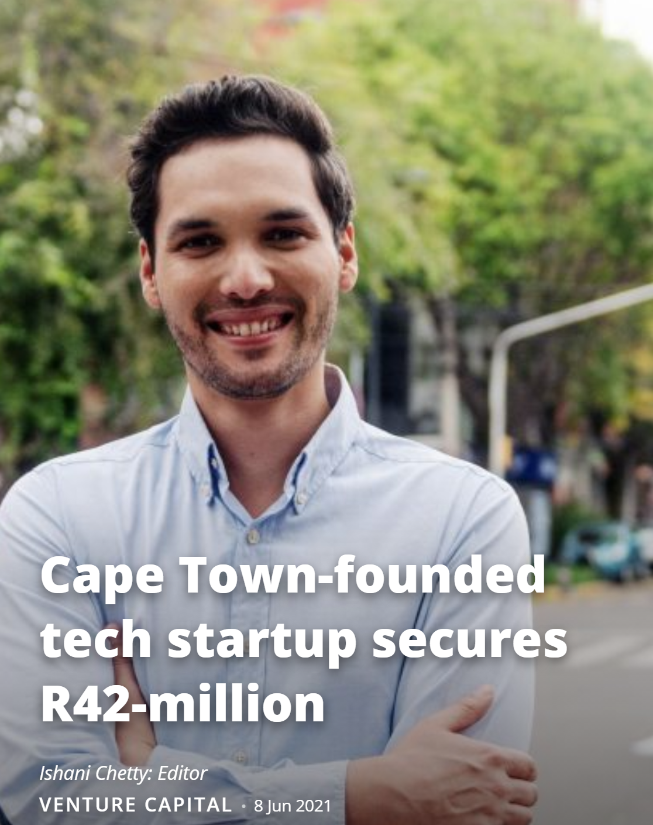

Finance for SMMEs vs startups
In the world of entrepreneurship, it often seems that the way to be successful is to raise a large sum of money that makes the headlines, like in the stories often see online. However, these are often only the outliers, and do not show the whole picture of what being a successful entrepreneur is all about.
The nature of startups is that they are high risk with high growth potential that requires significant risk capital to reach a steady state. Attracting this capital is difficult, as it requires convincing investors that the model or innovation is high growth, unique, scalable and worth the risk.
The other side of the scale is the steady, gradually growing SMME. These usually utilize a model that has already been proven and can attract a more stable form of financing. Instead of trying to convince investors of high growth, SMMEs can focus on building out their business sustainably while getting on board the right type of financing. This way, there is less risk in the business and a higher likelihood of growing a resilient business.
Both startups and SMMEs have their place in the world of entrepreneurship, but it’s important to understand which one applies to the type of business you’ve started and the risks you are willing to take.

Slide 27
SMME vs Startup
The terms SMME and startup are often used interchangeably, but they are not the same thing and attract very different forms of finance. This table shows some differences between them.
 | SMME | STARTUP
GEOGRAPHIC PERSPECTIVE | Local | Global / Multinational
BUSINESS MODEL | Traditional business model, works from day one. | Adapting business model / new product, in search of the model that works.
SCALABILITY | Limited - usually enabled by people, stock or equipment. | High - usually technology or IP enabled.
GROWTH RATE | Gradual | Fast
FINANCING | Should generally generate revenue immediately. | May require financing and significant time to start generating revenue.
RISK & RETURNS | Business risk but potential to generate low, steady returns. | Market, technology & business risk. Has the potential to generate significant returns at points in time.
Notes:
This slide should be a discussion with the entrepreneurs as it the framing is important to how they approach financing. Make sure you champion SMMEs and small businesses, as they may not be as “sexy” but being realistic about what type of business you are means being realistic about the types of finance you can access

Slide 28
[FLOW CHART 4]
Opportunities & Growth
There are many ways in which a business can grow. It’s important to understand your growth strategy before finding the finance to match it. This flowchart is a simple example of some of the growth directions that businesses can take
Are you looking to grow or expand your business?
Remember: a small business has a known business model that serves a local market. Startups are focused on disruptive models with rapid growth
Yes
Are you a small business?
No
Startup Growth
No
Yes
Small business growth
No current growth plans
Do you have a product that has been validated in a market?
Do you have plans to invest in new equipment or products?
No
Yes
Yes
No
Launch a tech product
Expand internationally
New products and / or equipment
Refinancing, cash flow support, buying inventory

Slide 29
The financing matrix below shows examples of the types of financing that are available for various types of growth and opportunities that might be available to the entrepreneur
[FUNDING MATRIX 4]
Opportunities & Growth
 | DEBT |  |  |  |  | INVESTMENT
Growth possibilities | Bank overdraft | Bank loan | SMME Financier* | Secured loan | Gov. loan | Family / friends | Angel investor | Venture Cap
STARTUP GROWTH
Launch a tech product |  |  |  |  | ⬤ | ⬤ | ⬤ | ⬤
International expansion |  |  |  |  | ⬤ |  |  | ⬤
SMALL BUSINESS GROWTH
Launch a new product |  |  |  | ⬤ |  | ⬤ | ⬤
Buy stock | ⬤ |  | ⬤ |  |  | ⬤ | ⬤
Invest in equipment |  | ⬤ |  | ⬤ | ⬤ |  | ⬤
Improve cash flow | ⬤ |  | ⬤ | ⬤
Refinance a loan |  | ⬤ | ⬤ | ⬤
*SMME Financiers are non-bank lending organizations that specialise in short to medium term debt

Slide 30
Industry sector specific opportunities
The industry sector that a business is in can be important for funding opportunities, as there are typically targeted financing opportunities for specific industries. These can be either public or private opportunities, and will have their own requirements
What sector is the business in?
Industries or sectors are groupings of businesses that are engaged in similar types of activities. For example, mining is one of the biggest sectors in the South African economy and consists of many companies, including those that supply to those doing the mining.
A business can be part of multiple sectors, but will usually define themselves by the sector in which they primarily operate in. If a business is uncertain about their sector, they can look to their main activities and customers/clients, which will likely be within a single sector.
Examples of industry funding
Some examples of industry specific funding are as follows:
Mining - Anglo-American Zimele Fund
Agriculture - Agro-Processing Support Scheme
Manufacturing - Light Manufacturing Fund IDC
Tourism - Tourism Support Programme
Construction - Construction Cares Fund
Specific forms of financing exist for business in certain sectors, particularly when a business can prove that they have a strong track record and that they can play a role in growing the sector and creating jobs

Slide 31

Summarise your financing options
Now that you have filled out your entrepreneur card, it’s time to reflect on whether you need finance and, if you do, how you can begin researching into the best options for you. Write down your summary in the box in the bottom right corner on the reverse side of your financing card worksheet
When writing your summary, make sure you include the following:
Three things you have understood about your business’s financing readiness.
Three types of financing you would like to explore further, and look towards in the future. Use the database to find specific options that might interest you.
Three things you can do in your business to be prepared for the financing you can access.
To get this done, check the documentation requirements of potential funders and make a list of what you should get done to apply for this type of financing.

Slide 32
What are different funders looking for?
Debt funders:
Debt funders make money by generating interest from loans that they issue. The interest usually depends on how long the financing is for and how risky it is to lend to a company.
General things to note
A business must be generating revenue, often above R1 million per year, or have an asset that they can use for surety.
Debt funders do not take any stake in the business, but will be the first to be paid out if the company fails.
Failure to pay a secured loan will mean that they will repossess the asset that it is linked to.
Important to understand the terms of any debt and that to have a plan in place to make repayments.
Equity funders:
Equity funders provide financing to a business in exchange for a part ownership of this business.
General things to note
They are also likely to have some influence on business decisions, depending on the size of ownership and the agreement between the shareholders.
Making an equity investment means taking a higher risk than someone providing debt financing. This means they are often looking for a higher return
It is important to show an equity investor that the business will make returns, either in terms of growing bigger or sharing profits with them.
An equity investment usually takes longer to conclude, as the investor needs to do a proper due diligence on the business.
Notes:
Debt funders:
Debt funders, such as banks or SMME loan companies, generally make money by generating interest from loans that they issue. The interest usually depends on how long the financing is for and how risky it is to lend to a company.
The general requirements of debt funders is to either be generating revenue, often above R1 million per year, or to have an asset that they can use for surety. In each case, this helps prove to the debt funder that you will be able to pay back the loan.
Debt funders do not take any stake in the business, but will be the first to be paid out if the company fails. Failure to pay a secured loan will also likely mean that they will repossess the asset that it is linked to.
It is important that you understand the terms of any debt that you take on and that you have a proper plan in place to make repayment
Equity funders:
Equity funders provide financing to a business in exchange for a part ownership of this business. They are also likely to have some influence on business decisions, depending on the size of ownership and the agreement between the shareholders. Selling equity in your business does mean that you will give up some control
A person or organization that is making an equity investment is taking a higher risk than someone providing debt financing. As a result, they are often looking for a higher return on their investment than a debt funder would be looking for.
This means that it is important to show an equity investor that the business will make returns, either in terms of growing bigger or sharing profits with them. An equity investment usually takes longer to conclude than taking on debt financing, as the investor needs to do a proper due diligence or assessment on the business.

Slide 33

Documents and application requirements
Before providing finance, a funder will require various documents to check if the business is legitimate and that assess the risks of lending or investing in that business.
Debt funders will typically need less documentation, as cash flow and financial position are more important to them. Many debt funders will typically ask for cash flow statements or bank statements or evidence of contracts.
Equity funders will require different documentation based on the size and stage of investment into a company. The assessment that equity investors undergo is called due diligence and is usually much more comprehensive.
Examples of documents that might be needed:
Registration documents
Tax clearance pin
3-6 months of bank statements
Financial statements
Business plan
Financial projections
BEE certificate
Details of directors
Industry compliance documents
Invoices to customers
Contracts / tender documents
Additional documents required for grant applications

Slide 34
LET’S TALK FINANCING

