Slide 1



YOUR LOGO AND SPONSOR’S LOGO HERE
WELCOME MENTORS
What you need to know to be a great mentor
Notes:
Schedule 60 - 90 minutes for the briefing session. Adapt title to suit your programme / tone.
Welcome everyone by name as they enter the room.

Slide 2
How to use this template
*DELETE BEFORE PRESENTING*
It is important that mentors are briefed on the programme and your expectations before they engage, possibly even trained
This slide deck suggests an agenda and topics for either a virtual or online mentor briefing: you may find it quicker and more useful to run this in a group
Take this slide deck and replace all highlighted areas with your own content, following the instructions if they’re helpful
You can also add your own content or adjust the language to suit your style
You can add your own branding (see suggested positioning on slides), but please keep reference to UK-South Africa Tech Hub as illustrated below, as this content has been developed and distributed under a CC-BY open access license.
{YOUR LOGO}
{SPONSOR’S LOGO}
This material was developed by the UK-South Africa Tech Hub and is distributed under a Creative Commons CC-BY 4.0 license,
as part of its mandate to build inclusive digital economies. This attribution is not an endorsement.

Slide 3
Welcome to [your hub name]
[include logo]
[give an overview of hub and activities - one slide only!]
{YOUR LOGO}
{SPONSOR’S LOGO}
This material was developed by the UK-South Africa Tech Hub and is distributed under a Creative Commons CC-BY 4.0 license,
as part of its mandate to build inclusive digital economies. This attribution is not an endorsement.

Slide 4

Intro yourself in 30 seconds
Your name
Your “day job”
Something unique you feel you’ll bring to mentorship
{YOUR LOGO}
{SPONSOR’S LOGO}
This material was developed by the UK-South Africa Tech Hub and is distributed under a Creative Commons CC-BY 4.0 license,
as part of its mandate to build inclusive digital economies. This attribution is not an endorsement.
Notes:
Allow everyone in the room / call to introduce themselves briefly

Slide 5

House rules
Cameras on for break-outs, group discussion and guest speakers.
If you need to leave, please excuse yourself.
Share your experience and be open to others’.
Anything else?
{YOUR LOGO}
{SPONSOR’S LOGO}
This material was developed by the UK-South Africa Tech Hub and is distributed under a Creative Commons CC-BY 4.0 license,
as part of its mandate to build inclusive digital economies. This attribution is not an endorsement.
Notes:
These house rules apply to briefing groups.
You can use the last point to get feedback from the group.

Slide 6
About [name of programme]
[address the following points; it may take more than one slide]
  Objectives of programme
  Overall design of programme
  Other activities, if any (how mentorship complements these)
  Purpose of mentorship in this programme: What change do you hope the mentorship will make for beneficiaries?
  High-level timeline
{YOUR LOGO}
{SPONSOR’S LOGO}
This material was developed by the UK-South Africa Tech Hub and is distributed under a Creative Commons CC-BY 4.0 license,
as part of its mandate to build inclusive digital economies. This attribution is not an endorsement.

Slide 7
About the Entrepreneurs
[Tell the mentors about the entrepreneurs]
  Typical profile of entrepreneurs in the programme (age, gender, business experience etc.)
  Key needs / challenges of entrepreneurs in programme
{YOUR LOGO}
{SPONSOR’S LOGO}
This material was developed by the UK-South Africa Tech Hub and is distributed under a Creative Commons CC-BY 4.0 license,
as part of its mandate to build inclusive digital economies. This attribution is not an endorsement.
Notes:
This is critical to discuss, as mentorship is a personal and personalised experience.

Slide 8

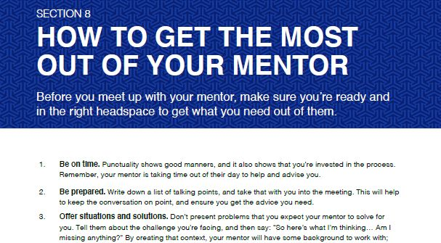
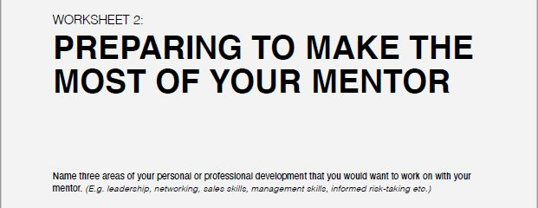
Mentorship Guide
{YOUR LOGO}
{SPONSOR’S LOGO}
This material was developed by the UK-South Africa Tech Hub and is distributed under a Creative Commons CC-BY 4.0 license,
as part of its mandate to build inclusive digital economies. This attribution is not an endorsement.
Notes:
Entrepreneurs will receive a mentorship guide, full of tips and worksheets. It will also be useful to go through this yourself to see how they have been prepared and briefed for their interactions with you.

Slide 9

Mentorship Fundamentals
{YOUR LOGO}
{SPONSOR’S LOGO}
This material was developed by the UK-South Africa Tech Hub and is distributed under a Creative Commons CC-BY 4.0 license,
as part of its mandate to build inclusive digital economies. This attribution is not an endorsement.
Notes:
Right, let’s get started.

Slide 10
“A mentor is someone who allows you to see the hope inside yourself.”
Oprah Winfrey
{YOUR LOGO}
{SPONSOR’S LOGO}
This material was developed by the UK-South Africa Tech Hub and is distributed under a Creative Commons CC-BY 4.0 license,
as part of its mandate to build inclusive digital economies. This attribution is not an endorsement.
Notes:
What makes a good mentor?
A mentor has experience that they want to share. But they are not there to tell the entrepreneur what to do.
A mentor shares stories but keeps confidences: they build trust with their mentee.
A mentor wants the best for their mentee and that includes helping them to become the best entrepreneur they can be.
And being a great entrepreneur includes having self confidence, self awareness, grit and the ability to learn from mistakes.
A mentor gives them the space to realise that. So what a good mentor does is listen, provide options and… care.

Slide 11
Mentors work
Encourages entrepreneurship: US students who were assigned an entrepreneur mentor were 20% more likely to pursue an entrepreneurial career two years after graduation
Improves performance: Female microenterprise owners in a Kenyan township, mentored by an experienced entrepreneur from the same community, increased short-run profits by 20% on average
{YOUR LOGO}
{SPONSOR’S LOGO}
This material was developed by the UK-South Africa Tech Hub and is distributed under a Creative Commons CC-BY 4.0 license,
as part of its mandate to build inclusive digital economies. This attribution is not an endorsement.

Slide 12
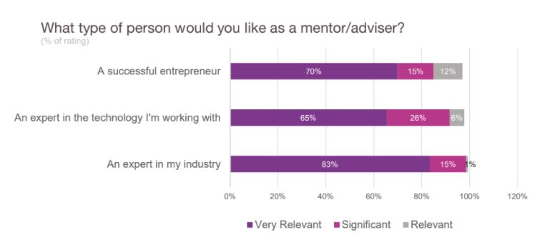
What type of mentors?
{YOUR LOGO}
{SPONSOR’S LOGO}
This material was developed by the UK-South Africa Tech Hub and is distributed under a Creative Commons CC-BY 4.0 license,
as part of its mandate to build inclusive digital economies. This attribution is not an endorsement.
Notes:
Entrepreneurs are relatively confident in their own technical skills, but want people who can help them understand the broader industry and business world.

Slide 13

What mentors do
Share experiences
Once established, share advice
Offer motivation
Challenge the entrepreneur
Listen actively
{YOUR LOGO}
{SPONSOR’S LOGO}
This material was developed by the UK-South Africa Tech Hub and is distributed under a Creative Commons CC-BY 4.0 license,
as part of its mandate to build inclusive digital economies. This attribution is not an endorsement.
Notes:
1. Share advice. They will offer information and suggest options that are relevant to your business goals. They’ll also tell you (honestly) when you’re going down the wrong path.
2. Share experiences. Typically, your mentor will have already walked down the same road you’re currently on. They’ll share stories and lessons from their career, which will be applicable to your situation.
3. Offer motivation. When the going gets tough, your mentor will provide encouragement and emotional support to inspire you to carry on.
4. Challenge you. They’ll push you out of your comfort zone, challenging you to try new/different approaches.
5. Listen actively. They’re a sounding board for your ideas, and will provide feedback on what you’re saying.

Slide 14

What mentors DON’T do
Teach the entrepreneur how to perform specific tasks
Tell the entrepreneur what to do
Act as a therapist
Do all the talking
Simply sit and listen
{YOUR LOGO}
{SPONSOR’S LOGO}
This material was developed by the UK-South Africa Tech Hub and is distributed under a Creative Commons CC-BY 4.0 license,
as part of its mandate to build inclusive digital economies. This attribution is not an endorsement.
Notes:
1. Teach you how to perform specific tasks. Sure, they know how to set up a spreadsheet; but that’s not the kind of expertise you want from them. You’re looking for big-picture advice on aspects such as strategic decisions, staff and relationship management, and managing business finances.
2. Tell you what to do. They will share their advice and ways of thinking, but the actual decision-making is up to you.
3. Act as a therapist. Don’t expect your mentor to be your confidante and your guidance counsellor. Yes, aspects of work and life will overlap – but don’t unpack your personal issues when you’re really looking for business advice.
4. Do all the talking. Mentorship is a two-way street. As much as you’re picking your mentor’s brain, remember that you also have valuable insights to share from your point of view. Your mentor will want to hear those as well.
5. Simply sit and listen. They should ask questions and provide throughout the conversation. If they don’t, stop and ask them: “What would you advise?”

Slide 15
The 3As of Mentorship
Stops Talking
Active Listening
Guides the Conversation
Provides Feedback
3 A’s of Mentorship
Availability
Keeps Appointments
Pays Attention
Manages Boundaries
Analysis
Honesty with Diplomacy
Offers Insights
{YOUR LOGO}
{SPONSOR’S LOGO}
This material was developed by the UK-South Africa Tech Hub and is distributed under a Creative Commons CC-BY 4.0 license,
as part of its mandate to build inclusive digital economies. This attribution is not an endorsement.

Slide 16

MENTORS
&
POWER DYNAMICS
{YOUR LOGO}
{SPONSOR’S LOGO}
This material was developed by the UK-South Africa Tech Hub and is distributed under a Creative Commons CC-BY 4.0 license,
as part of its mandate to build inclusive digital economies. This attribution is not an endorsement.
Notes:
Keep in mind that there will be a power dynamic between you and your mentee: they may be in awe of you, they may believe that they need to do what you say, or they may feel the need to push back in unconstructive ways. Aim to hold, not dominate, the relationship and for your mentees to become comfortable with this: always assert their own agency and let them guide conversations as much as you do.
Photo by Ivan Diaz on Unsplash

Slide 17


WHAT’S IN IT FOR THE MENTOR?
Personal Benefits
  Improved leadership skills
  Increased confidence
  Leaving a legacy
Professional Benefits
  Bolstered CV
  Broadened network
  Learning opportunities
{YOUR LOGO}
{SPONSOR’S LOGO}
This material was developed by the UK-South Africa Tech Hub and is distributed under a Creative Commons CC-BY 4.0 license,
as part of its mandate to build inclusive digital economies. This attribution is not an endorsement.
Notes:
Personal BENEFITS
• Improved leadership skills: This is a chance to practice your leadership and soft skills in a context that is not the hierarchy of a company.
• Increased confidence: Become more confident in articulating your advice, share the path of how you have developed (reflect on your own journey), learn “servant leadership” (creating the space for others to grow, secure in yourself).
• Leaving a legacy: What better way to leave a mark on an industry than by acting as a mentor to a rising generation?
Professional BENEFITS
• Bolstered CV: Mentorship demonstrates an ability to lead, train and develop talent.
• Broadened network: Mentors get access to other mentors, and to younger entrepreneurs who are entering the industry. This expands your contacts list, and puts you in touch with exciting new ventures.
• Learning opportunities: Through teaching, one also learns. Being a mentor helps to reinforce (or challenge!) existing knowledge, and pushes you to stay up to date on the latest trends and technologies.

Slide 18

Notes:
5 minutes

Slide 19
How we will work together?
[Describe how your programme will be managed, covering the following points]
  Who do the mentors report to? Who do they ask about administrative issues?
  How are bookings managed?
  What communication tools and platforms are used? What are the rules of engagement?
{YOUR LOGO}
{SPONSOR’S LOGO}
This material was developed by the UK-South Africa Tech Hub and is distributed under a Creative Commons CC-BY 4.0 license,
as part of its mandate to build inclusive digital economies. This attribution is not an endorsement.

Slide 20
How we’ll match you with mentees
[describe your matching process, covering the following points]
How long is the engagement?
Who selects who?
In what way will you be introduced? (Webinar? One-on-ones? “Speed dating”?
{YOUR LOGO}
{SPONSOR’S LOGO}
This material was developed by the UK-South Africa Tech Hub and is distributed under a Creative Commons CC-BY 4.0 license,
as part of its mandate to build inclusive digital economies. This attribution is not an endorsement.

Slide 21
Reporting and check-ins
[Describe the reporting requirements and rhythms]
  How often and in what detail are they expected to give feedback / report?
  Take them through your reporting frameworks if necessary - template available in the Toolkit
{YOUR LOGO}
{SPONSOR’S LOGO}
This material was developed by the UK-South Africa Tech Hub and is distributed under a Creative Commons CC-BY 4.0 license,
as part of its mandate to build inclusive digital economies. This attribution is not an endorsement.

Slide 22
How we work with entrepreneurs
[Describe expectations of behaviour]
  Reiterate hub / programme values
  No discrimination or harassment tolerated
  Be timeous and respectful of time
  Maintaining confidentiality
  How we and you protect data
  Explain process for dispute resolution, if necessary
{YOUR LOGO}
{SPONSOR’S LOGO}
This material was developed by the UK-South Africa Tech Hub and is distributed under a Creative Commons CC-BY 4.0 license,
as part of its mandate to build inclusive digital economies. This attribution is not an endorsement.

Slide 23
Ending the relationship
Suggest an agenda for the final session, which could include:
  Reflection on what has changed
  Summary of current status
  Next steps to be taken independently (potentially including alternatives to the mentorship)
You may want to continue the relationship in an informal capacity [what is your hub’s policy on this?]
{YOUR LOGO}
{SPONSOR’S LOGO}
This material was developed by the UK-South Africa Tech Hub and is distributed under a Creative Commons CC-BY 4.0 license,
as part of its mandate to build inclusive digital economies. This attribution is not an endorsement.
Notes:
We suggest a formal closure to a series of mentorship sessions so that there is closure for both parties and will facilitate this in the following way [describe in the context of your programme design].

Slide 24
Contracting mentors
Our service level agreement clarifies the following:
[Take mentors through your SLA - you can use the template in the Toolkit - explaining these points]
  Time commitment and deliverables
  Expected behaviour and performance
  Remuneration (if applicable)
{YOUR LOGO}
{SPONSOR’S LOGO}
This material was developed by the UK-South Africa Tech Hub and is distributed under a Creative Commons CC-BY 4.0 license,
as part of its mandate to build inclusive digital economies. This attribution is not an endorsement.
Notes:
Finally, take them through the details of the contracting. You may want to deal with some of these details individually.

Slide 25

Questions?
{YOUR LOGO}
{SPONSOR’S LOGO}
This material was developed by the UK-South Africa Tech Hub and is distributed under a Creative Commons CC-BY 4.0 license,
as part of its mandate to build inclusive digital economies. This attribution is not an endorsement.

Slide 26
Additional resources
MakeIT’s Mentor-driven Capital for Entrepreneurial Success:
A Mentorship Guide
Mowgli Mentoring’s What is Mentoring?:
https://www.mowgli.org.uk/what-is-mentoring
Wishing you and your mentees great growth!
{YOUR LOGO}
{SPONSOR’S LOGO}
This material was developed by the UK-South Africa Tech Hub and is distributed under a Creative Commons CC-BY 4.0 license,
as part of its mandate to build inclusive digital economies. This attribution is not an endorsement.

Slide 27


YOUR LOGO AND SPONSOR’S LOGO HERE

