Slide 1

MODULE 4:
How do I make money?
Notes:
PLAY Launch League canvas video 4 (The business operations) now.

Slide 2
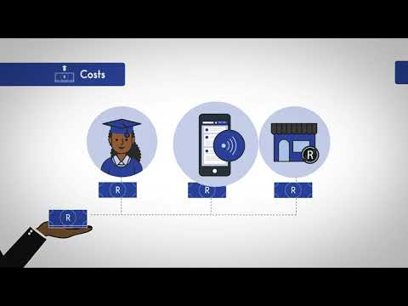

Slide 3

What is Launch League?
This programme material was originally developed by the British High Commision UK-South Africa Tech Hub and Viridian through the Launch League initiative.
Launch League creates material and training/ networking opportunities for South African hubs and training organisations, so that we can better support YOU – promising entrepreneurs from our community!
www.launchleague.co.za

Slide 4

1.
Business model

Slide 5
A business model is how you create and deliver value to your customers and how you capture value from them.
Notes:
Your business model is the big picture of a healthy business. A healthy business makes money. Specifically, it makes more money than it spends.

Slide 6
Business Model
1. Create Value = Product or Service
2. Deliver Value = Customer Value Proposition / benefits
3. Capture Value = Income / revenue (that exceeds your costs)
You need all three to have a business!
Notes:
Your business model is the description of the way that you take the value that you deliver to your customers -- the product or service that they’re happy to pay for -- and turn it into a profit for your business. If you have a product, but no customers, then you don’t yet have a business. If you have a product and people that say they want it, but you can’t sell it to them at a price that they’re willing to pay, you don’t yet have a business. If you are selling your product or service to people for less than what it costs you to make and deliver it, then your business needs help!

Slide 7

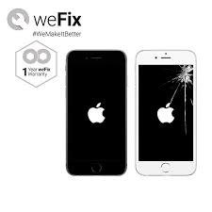

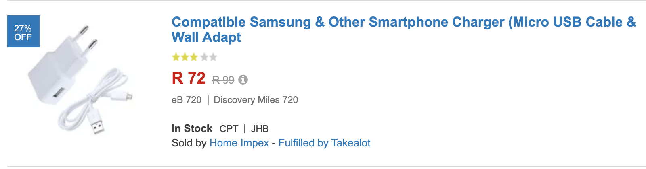
Think about the various business models for the following products
R499
Notes:
How do the models shown here offer value and make money? [Ask participants to share some thoughts, or prompt them by starting on one or two yourself.]
Airtime voucher = pay-as-you-go. The airtime is more expensive that it would be on contract, but the customer can buy it as they need it.
Cellphone contract = subscription model. The customer has to pay a fixed sum, but gets the services cheaper. This model is less onerous for the supplier to manage and also guarantees retention.
Repairs = Transaction model: The customer gets to extend the lifespan of their device at a location that is convenient to them, and usually cheaper and quicker than the “official” suppliers.
Online shop = marketplace model: Customers can compare various cellphone accessories and buy a good-enough product at a better price. Suppliers can compete across different variables (price, accessibility, quality) to appeal to different customers.
Airpods = add-on model: Customers are in love with their iPhones and want the latest tech, design and status symbol from Apple. Apple generates more revenues and increases customer loyalty.

Slide 8
Business Models
Most businesses focus on ONE business model:
Direct sales model
Add-on business model
Marketplace model
Pay-as-you-go model
Subscription model
Transaction model
CAUTION! Freemium models and advertising based models are almost impossible to get to work.
There are many different business models and a lot of information is available online.
Notes:
[Choose 2 or 3 of the models described to explain to the participants, based on their interests / businesses if possible.]
Direct sales model: Under a direct sales business model, sales of products or services generate revenue through a network of salespeople, who sell directly to customers. There’s usually no “shop” involved, rather individuals are given entrepreneurial tools and supported with marketing materials. Example: Avroy Shlain cosmetics sales.
Add-on business model: Fees or charges that are added to the basic price of a good or service for additional features or benefits, such as those added to the price of a car for accessories. The real key is to add on high-margin products or services. Example: Mags on a car.
Marketplace model: An online marketplace is basically an eCommerce website or an application which organises the products and services of different companies/sellers and sell them on its own website. The firm only acts as a mediator and doesn't own the products or services provided. Example: Takealot.
Pay-as-you-go model: Any type of payment structure in which a customer has access to potentially unlimited resources but only pays for what they actually use. Example: Airtime.
Subscription model: Subscription business models charge a customer a regular payment in exchange for access to products or services for a set period of time. Predictable recurring revenues is the most obvious benefit of this business model to the supplier.
Transaction model: The customer pays for what they get -- the business needs to make each new sale to the customer on its own merits (unlike the subscription model). Example: Most businesses, for example, a nail salon.
Often entrepreneurs starting a tech or app business think that they will acquire customers through a freemium model or generate
Fremium: Under a freemium model, a business gives away a service at no cost to the consumer as a way to establish the foundation for future transactions. The freemium model tends to work well for Internet-based businesses where it's cheap to acquire customers, and those who convert to paying will pay well over a long period of time. The service and choices available have to be extremely competitive. Example: Spotify.

Slide 9



Let’s revisit our example….
ABC Tutors provides an affordable, locally available tutoring service for high school learners, delivered by university students.
Can you spot their business model?
A+
R
High quality tutoring
which will improve
your child’s marks
University students tutor learners in groups
Parents pay per lesson
Notes:
ABC Tutors charges parents per lesson their child attends. Parents pay cash at every lesson. ABC Tutors has a transactional business model.

Slide 10
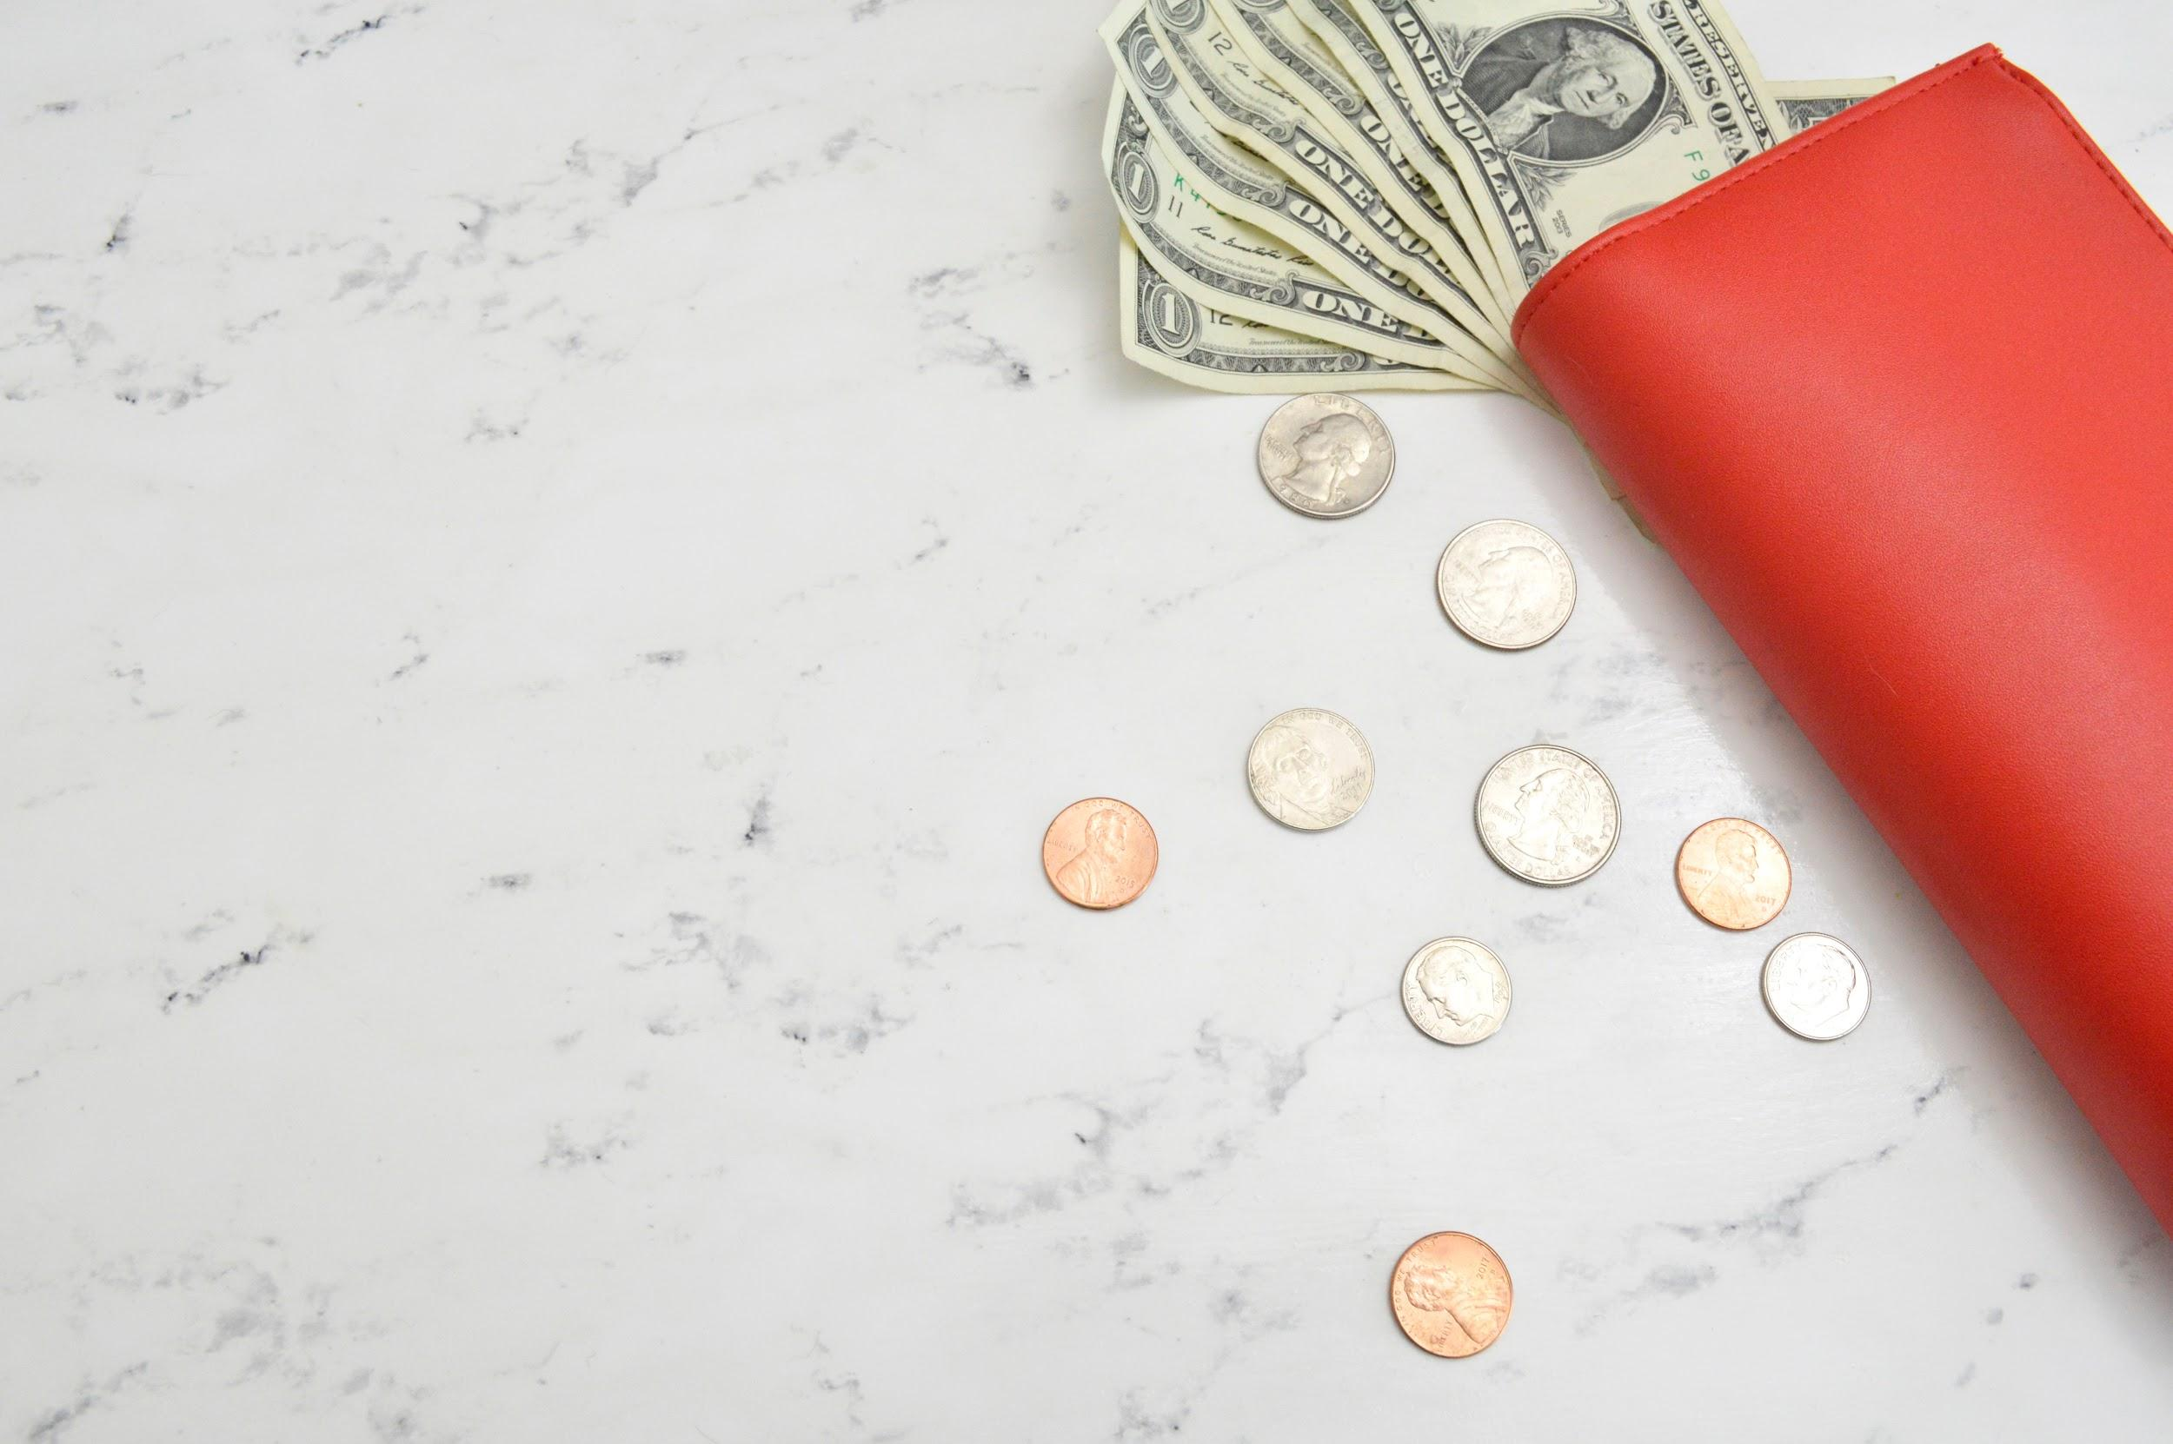
2.
Income
Notes:
Right, let’s get to the good stuff!
[Question for the audience: Who of you likes to think about the money your business make? [People will put up their hands] Who likes to think about how much it costs your business to make that money? Who of you likes to spend time with the Excel spreadsheet of your Income statement? Who likes to think about how much tax you might need to pay at the end of February and why? [Probably very few people!]]

Slide 11
If you don’t understand the details of your business, you are going to fail.”
Jeff Bezos
Notes:
A lot of people consider the details of how their business makes and manages money to be boring or secondary.
Listen to Jeff Bezos (founder of Amazon): a man worth $114 billion can’t be wrong.
Be like Jeff!

Slide 12
Income
Now that you have a better idea about business models, how are you going to generate income?
Income is any money that is paid to you for sale of products, services, rent or even interest on money you’ve saved.
Notes:
[Read definition on slide.]

Slide 13

Let’s revisit our example….
ABC Tutors provides an affordable, locally available tutoring service for high school learners, delivered by university students.
R
Pupils can pay cash on the day for R20 per lesson.
Parents can prepay for 6 lessons for R100 which gives them one lesson free.
Notes:
ABC Tutors takes R20 from pupils when they attend a lesson.
Here you can see that ABC Tutors have gotten clever by offering a subscription-like model -- a discount for parents who pay upfront -- which helps them get more reliable revenue.

Slide 14
Cost of sales
When you think about income you also need to think about what it costs to deliver your product or service to your customer, before you have any income left to pay yourself!
This cost, which is directly associated with each product or solution sold is called your cost of sales.
Sales (or Income) - Cost of Sales = Gross Profit!
Gross Profit is what's left for you to cover the costs of your business (your overheads).
Notes:
[Talk through what’s on the slide - pause to ask whether there are any questions or comments.]
[You may want to give some other examples of cost of sales.
For a business making bread, the ingredients and packaging of the bread would be part of their cost of sales.
For a business selling trendy T-shirts, buying the T-shirts, printing the design on it and paying commission to the “influencers” selling it would be part of their cost of sales.]

Slide 15

Cost of Sales
ABC Tutors uses university students to tutor groups of school learners.
The amount that ABC Tutors pays their student tutors is a cost of sales
for the business.
-
=
R70 per group GROSS PROFIT
R20 x 6 = R120 per group
INCOME
Less R50 per hour tutoring fee
COST OF SALES

Slide 16
Monthly income
Once you understand the basic mechanisms of how your business generates income and what the costs associated with generating income are, you can
start to forecast monthly income (work out how much money you could
make per month).
For ABC Tutors, if they tutored 18 students per day for 20 days per month, what would their gross profit per month be?

Slide 17
Income vs Gross Profit
For ABC Tutors, how much money are they receiving from customers
every month?
R120 (R20 x 6 per group) x 3 tutors x 20 days = R7 200 per month
But, remember, you are actually only retaining R70 per group, because of the payments you make to your tutors to deliver the service:
GROSS PROFIT:
R70 x 3 groups x 20 days = R4 200 per month

Slide 18
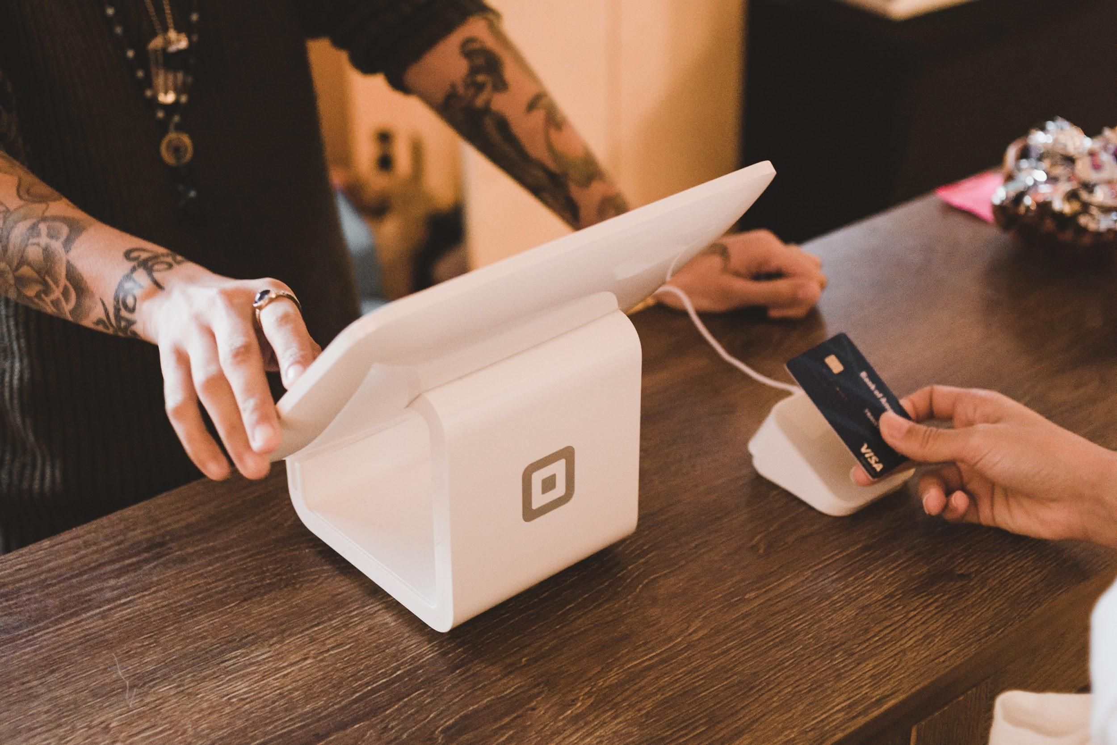
3.
Costs

Slide 19
Overhead costs
Overhead costs are basically anything that you need to pay to keep your business running. Most overhead costs are incurred on a monthly basis,
but some can be incurred annually.
These could include the following:
Accounting & bookkeeping fees
Bank charges
Printing & stationery
Rent
Telephone & internet
Office expenses
Utilities
Subscriptions
Travel
Salaries
Tax
Marketing
Notes:
Costs to run your business -- or overhead expenses -- are different to cost of sales in that they keep getting incurred whether you produce products and services, or not. It is important to not only plan for these costs, but to keep them under control, so that you can ride out dips in demand for your product.

Slide 20
Monthly costs
ABC Tutors keeps its monthly costs low, but they still add up:
COST | AVERAGE AMOUNT P.M.
Bank Fees & Accounting | R 200.00
Online Subscriptions (Email, website etc) | R 150.00
Telephone & Internet | R 250.00
Salaries | R 3 000.00
Printing | R 50.00
Travel | R 250.00
Rent (hot desk) | R 250.00
TOTAL | R4 150.00
Notes:
[Go through the costs briefly -- then ask participants: “Is ABC Tutors making or losing money?” The answer… breaking even!]

Slide 21
Break-Even
INCOME
NET PROFIT
BREAK
EVEN
POINT
PROFIT
OVERHEAD COSTS
GROSS PROFIT = OVERHEAD COSTS
LOSS
TIME
Notes:
You may have heard people referring to a business breaking even.
Break-even happens when your gross profit is equal to your overhead costs.
In other words, you first need to get your pricing right, so that the revenue you are receiving from customers is more than what it takes to deliver your product or service: this is called your gross profit.
If you are making enough from your sales to customers that you can also cover your overhead costs, then you have broken even.
When you can make enough from your sales to cover your cost of sales and pay your overheads, with some left over, then you are making a real profit! This is called your net profit.

Slide 22
Break-Even Analysis
Is ABC Tutors profitable? And how many groups do they have to service
to cover the monthly costs of the business?
Monthly Costs = R4 150.00
Gross profit per group = R70.00
Number of groups needed per month = R4 150.00 / R70.00
= 59.28 (60 groups per month)
R70 x 60* = R4 200 per month to break even.
(*3 groups per day x 20 days per month)
How could ABC Tutors become more profitable?
Notes:
[Talk through this slide. Ask whether everyone understands it.]
Q for participants: How could ABS Tutors become more profitable?

Slide 23
Profit
Many factors affect profits in a business, but you could consider the
following mechanisms to increase profit:
Increase prices
Increase gross profit by decreasing costs of sales
Increase sales
Decrease monthly costs (overheads)
Just be careful that you don’t compromise on the value you provide to your customers!

Slide 24
Costs
As your business grows your costs will grow too! You need to think about what additional costs your business will need to cover:
Professional services
Tax
Subscriptions
Office space for more staff
Salaries
Stock
Travel
Additional marketing
Business development
Insurance
Finance costs

Slide 25

Your turn!
Notes:
We are going to work on the income and costs blocks on your canvas now.

Slide 26
Business Model & Income
Using the business model and income worksheet, describe your business model and how you create, deliver and capture value. Use the template to understand how you generate income and what your cost of sales are, if any.
Once you have a first version of your business model and income model, test it by reading it out to someone. Ask them if they understand your business model and how you generate income.
Once you understand how you are generating income, complete the income block in your canvas.

Slide 27
Costs & Break-Even Analysis
Using the costs and breakeven analysis worksheet, list your costs to understand what you need to pay for each month to run your business, as well as a breakeven analysis to understand what your minimum monthly income or sales need to be.
Once you have a first version, test it by reading it out to someone. Ask them if they understand your costs and your break-even analysis.
Once you understand the costs in your business, complete the costs block in your canvas.

Slide 28
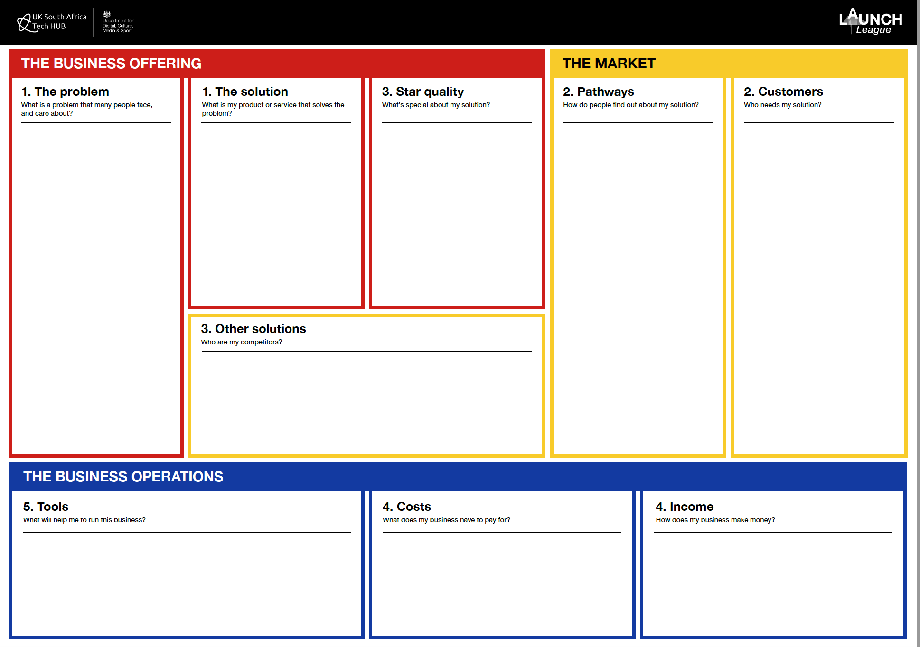
Notes:
Once you have completed your Income and Costs worksheets, you can enter these into your canvas.

Slide 29
ABC TUTORS
SA schools are overcrowded, lack resources pupils don’t get the support they need to achieve good marks.
They need additional support to get good marks & to get into uni.
There are limited options for after-hours tutoring that are affordable and safe for learners in Tshwane.
An affordable, group study service for high school learners at local libraries, where they are tutored by a local university student.
The group structure allows the service to be affordable.
By joining a tutoring group, pupils learn from others, receive tutoring support in person and online via a Whatsapp group.
Flyer & posters at taxi ranks
Facebook pages for parents
Referral basis between parents in exchange for a discount
Service delivered at the local library
Payment taken in cash from the pupils or parents can eft or buy a bulk pack of lessons which will save them money.
Reports and communication with parents via Whatsapp.
Working parents (both male and female) between 30 - 45 years old.
Value education & concerned that their children need extra tutoring. Support their child’s dream of going to university.
Earn R10k+ per month, cost conscious, have a smartphone, use public transport.
Users: High school students who want good marks and to go to university.
Other tutoring services which are more expensive or not available locally.
Substitutes or indirect competitors include homework groups, study guides, online videos, subject specific services or international services.
Cost of sales are tutor salaries.
Overhead costs include the co-ordinator salary, rent, subscriptions, internet and airtime, bank charges, printing and marketing.
Income is generated by selling packages or individual tutoring sessions to parents.
Cost of sales is the hourly fee to university students for tutoring groups.

Slide 30
4
3
TT
2
1
i
Notes:
Congratulations on making it this far! One more tech tools session and one more module, and you’ll finally be a Launch Leaguer!

Slide 31
MODULE 4:
How do I make money?

