Slide 1

Tech Tools 2:
Management, Finance
Notes:
In this second tech tools session, we’re going to look at a few free tools that will allow you to manage your business operations, and finances better. We can go into more detail on how to use these tools and maybe some other tools in the meetups.

Slide 2

What is Launch League?
This programme material was originally developed by the British High Commision UK-South Africa Tech Hub and Viridian through the Launch League initiative.
Launch League creates material and training/ networking opportunities for South African hubs and training organisations, so that we can better support YOU – promising entrepreneurs from our community!
www.launchleague.co.za

Slide 3
Organisation & Operations
Notes:
{Question for group - Who currently uses an app, software for your business organisation, operations and finances? List these on the flipchart/ board.}
{Allow for 5 minutes of discuss/ sharing of tools.}

Slide 4
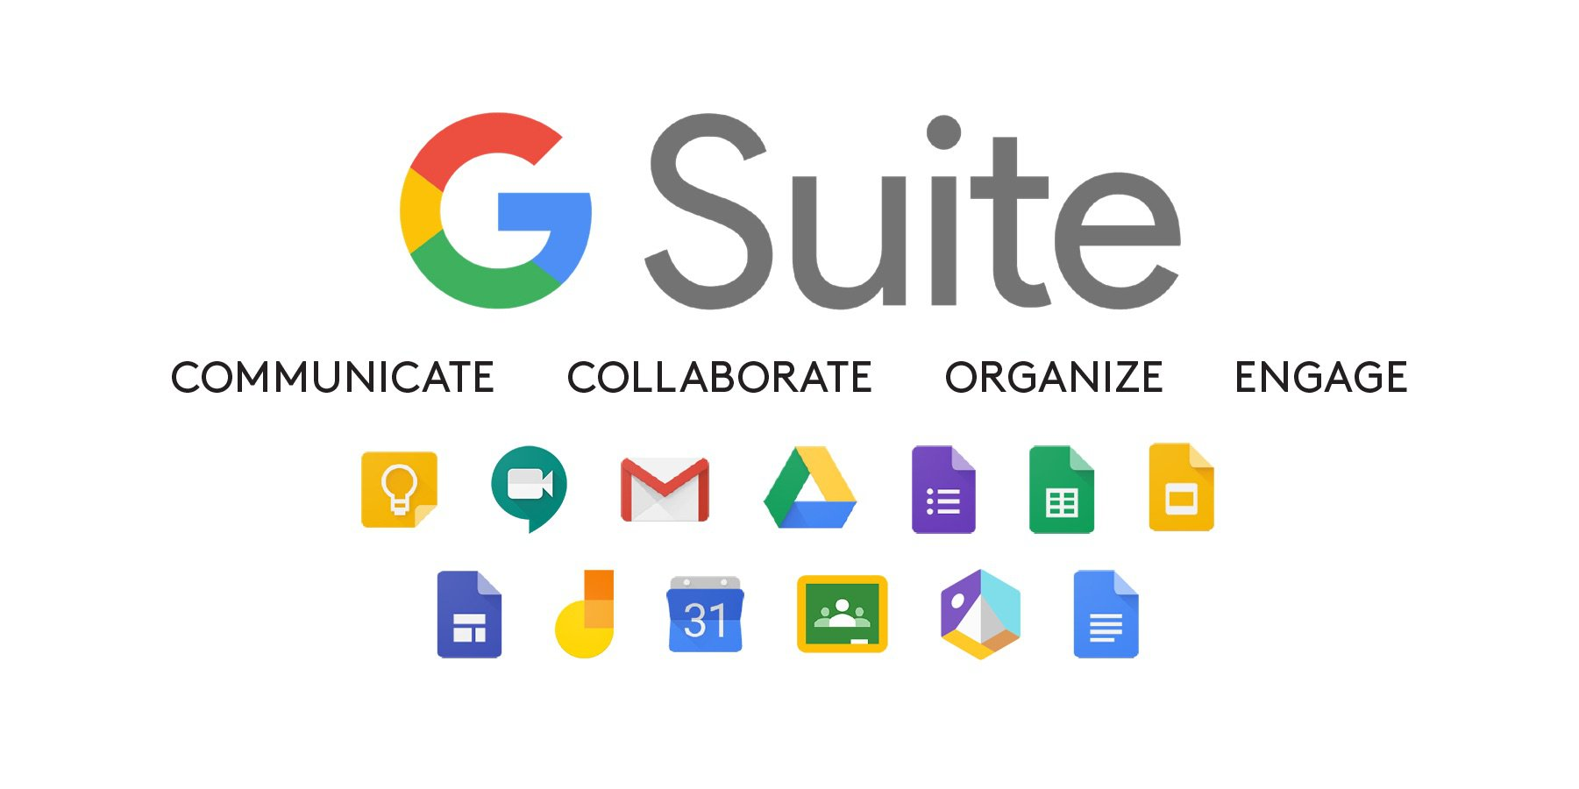
Notes:
We are going to start with G-suite.
{Question for group - who has a business gmail email address? Do you know that just by having a gmail address, you have access to 8 different tools that allow you to better manage your business.}
{Run through each tool and and ask the group their experience of using each.} - 5 minutes

Slide 5

Anyone can create an @gmail.com email address for free.
To have a customised business email address for you and your team, you need to subscribe to g-suite. (From $5,40 per user per month.)
Free gmail app for your phone
Notes:
Let’s start with gmail.
{Question for group - who uses their gmail address for their business? And who uses the gmail app on their phone?}
Anyone can create a gmail email address for free. Yourname@gmail.com or abctutors@gmail.com. But if you would like to create customised email addresses for you and your team, then you can subscribe to a google account and create@abctutors.co.za. These packages start from $4.50 per month.

Slide 6
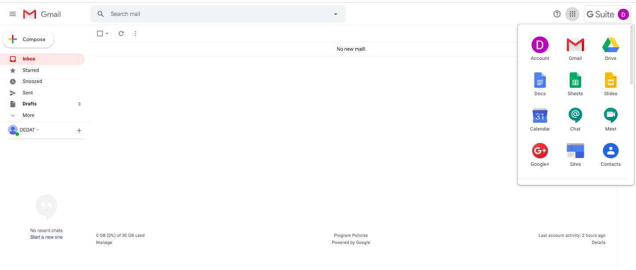
Notes:
To access the rest of your free g-suite, you can log on to gmail on your computer and click on the top right.
Or you can download the individual apps from your Play store.

Slide 7

Desktop & Mobile App
Create calendar entries for all your meetings, appointments, and also to reserve time to work on specific projects.
E.g. 2 hours every Friday to record expenses & income
Share your calendar
Set reminders about calendar entries
Notes:
{Question for group -- who uses your google calendar?}

Slide 8
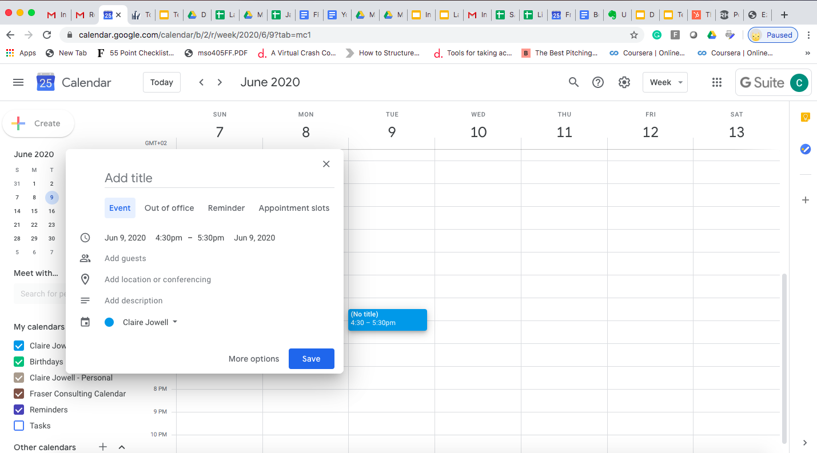
Let’s make a calendar event!
Notes:
Everyone take out your phone. Who has the google calendar app? If not, go to play store and download it.
Let’s all make a calendar event for for ourselves for next week’s meetup.
Add a title, the location, time and add the person next to you. And set a reminder for yourself.

Slide 9

Safely upload, store and share your files. Protect against theft or computer/ phone damage
15 GB of free space for individual users, more for business subscribers (comes with business email address). You can pay for extra storage (monthly) if needed.
Online, Computer App, Mobile App
Notes:
Google drive is a cloud storage tool, free to people with a gmail address.
{Questions for group -- Does everyone understand what we mean by the cloud? Who uses google drive? Does anyone use any other cloud tool?}
{Cloud definition -- In the simplest terms, cloud computing means storing and accessing data and programs over the Internet instead of your computer's hard drive. The cloud is just a metaphor for the Internet}
Google drive is your online safety box for your files. You can either upload your documents (Word, pdf) to google drive, or any of the docs, slidedecks, sheets that you create using the google tools will automatically get shared in your google drive. Your google drive folders can be shared with your team/ clients/ customers. You can choose to share certain photos or documents with different people. By having a shared google drive with your team members, you will always be able to access your files, no matter where you are.
As a free user you get 15GB of free space but this does include your gmail storage and also your google photos which may be automatically updating from your Android phone. You can buy extra storage for a monthly fee - for instance, an extra 100GB for R29 per month. As a google account subscriber (if you’ve chosen to subscribe to access business email addresses), you will receive more storage and can also upgrade this if it is not enough.
Google online -- access your drive on your web browser. You can upload any documents from your computer.
Google Computer app -- if you download the app for your computer, you can ensure that any documents or files saved to your computer will automatically be synched with your google drive.
Mobile app -- you can access your google drive on your phone as you go, and also save files from your phone to your Drive directly.

Slide 10



Google’s free online document, spreadsheet and slide creators.
All docs, slide, sheets created will be automatically saved in your drive.
Collaboration & Transparency. Many people can work on the file at the same time and you can track who makes which changes.
Notes:
These are also great tools if you need to create document, spreadsheets or slides but you don’t have Microsoft Office on your computer.
You can choose who you share the files with, and whether they can view, comment or edit on the file.
All changes made to documents are saved instantly, and you can also see who has made changes and when they are made. This allows you to collaborate with your team members.

Slide 11
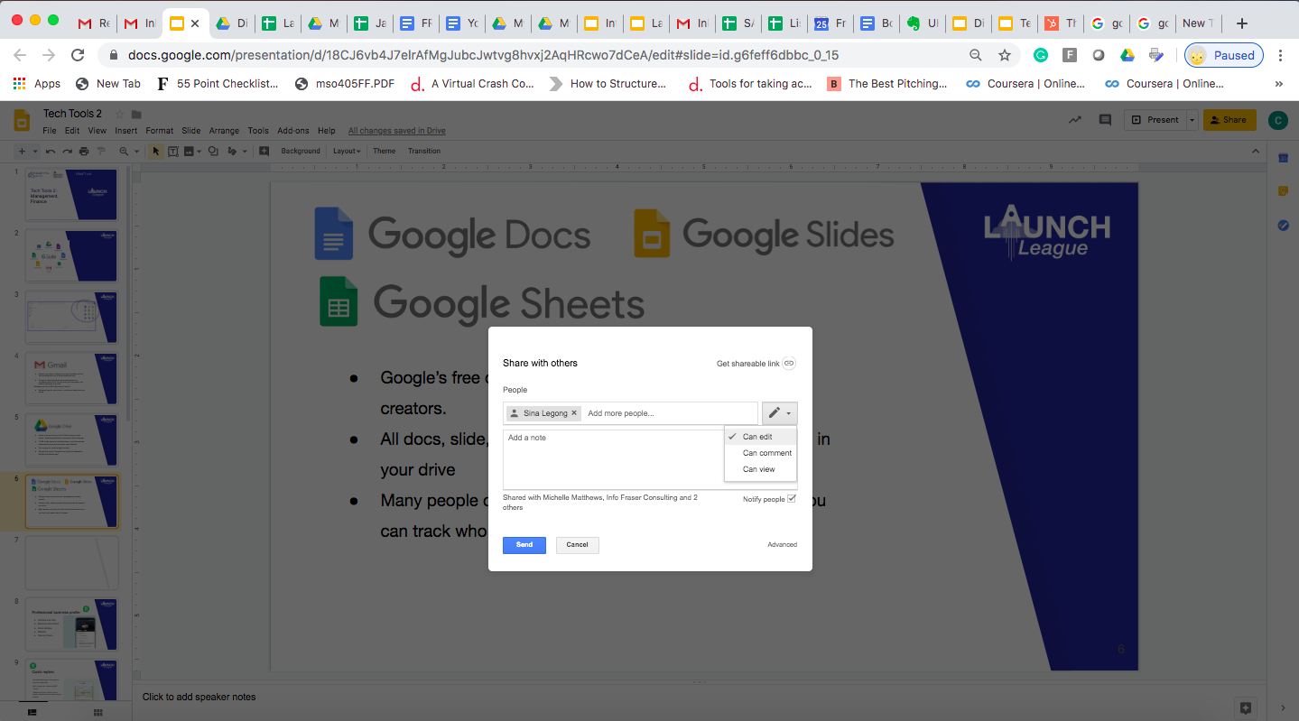
Notes:
In this screenshot, you can see that these slides were created in google slides. A few people were able to collaborate in creating them. By clicking share in the top right corner, you are able to share with someone and choose whether they can edit, just comment or just view.

Slide 12

Great tool for customer surveys, registration or orders
Only available for web (no mobile app yet)
All form entries can pull through to a live google sheet
Many different question types: multiple choice, short form, rating.
Results as graphs, charts for easy reading
Notes:
{Question for group -- who has used google forms? How have you used it? Have you filled out a google form before? Reference Launch League application form}
This is a valuable tool for customer validation, and customer feedback.

Slide 13

Use Google Meet for live voice calls or video calls with other google users.
Call one person or a group
Google automatically attaches a Google Meet link to your calendar event.
Notes:
{Question for group -- Does anyone use Skype or Zoom or any other tool to make business voice calls? Has anyone used Google Meet or Google Hangouts to make a call?}
Google Meet is a good voice call/ conferencing tools to use with colleagues or clients. A note that they will need a google account to use this but do not need any special apps to take a call on Meet on their computers. On their phones, they would need to have the Meet app downloaded.
When you schedule an event in google calendar, a google Meet lin is automatically included. Everyone one then clicks on this link at the time of the meeting and the call will open in the app or in their web browser.
You can choose to have your camera on or off, and can mute if you just want to listen in.

Slide 14
Payments
Notes:
{Question for group -- how do your customers prefer to make payments? How do you prefer to make payments?}

Slide 15




All require your customers to have a debit or credit card
Snapscan and Zapper require your customers to have downloaded an app
Notes:
{Describe each tool/ app} {Question for group -- which of these do you think would work best for your customers?}
We can go into more detail on these in the meetups if needed, but today we will just discuss Yoco.

Slide 16
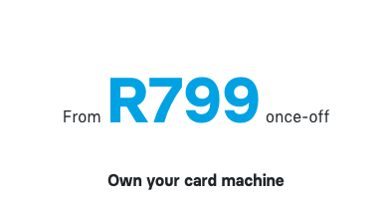
Fees February 2020
Yoco also provides a basic point of sale system
Yoco also provides working capital for businesses based on their past transaction history
Notes:
You can apply and pay for a card machine online, it will be delivered to you.
Minimum R1,73 per transaction.
Max transaction fee is 2.95% ex VAT but transaction fees decrease as your monthly turnover increases.

Slide 17
Invoicing
Notes:
{Question for group -- how do you currently send invoices and track your expenses?}

Slide 18

Free invoicing and basic accounting tool for small businesses
Online and mobile app for invoicing
Add your company logo and send invoices to clients straight from wave, with an attached pdf
Notes:
Wave is easy to use for invoicing, and can also be used for basic accounting -- tracking your expenses and income.
It is advisable to spend some time understanding the tool before you start using it, and whether you will be able to pull the reports you need for your business records.

Slide 19
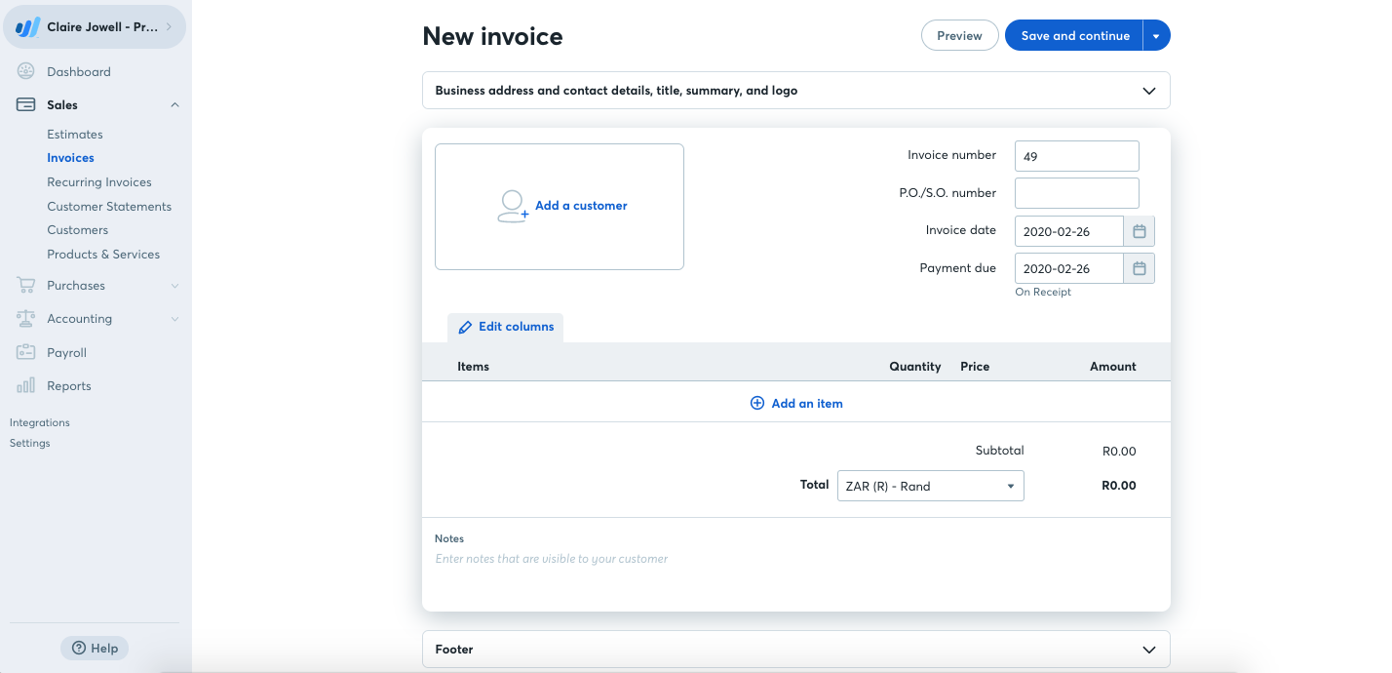
Notes:
When you log in to Wave, you can create a new invoice.
You can:
Add your customer details
The date that the payment is due
The details of the products or services
Your business address, company details or logo
And any notes you’d like to add
It will automatically assign an invoice number.
When the invoice is paid you can mark it paid on Wave.

Slide 20

Your turn

Slide 21
Customer validation
Write 3 questions that you’d like to ask your customers:
How they experience the problem
Whether they would use your solution
How much they would pay for your solution
What solutions they currently use
What pathways they use
How they want to pay for your solution

Slide 22
Customer validation
2. How are you going to do your customer validation?
Do you need a flyer?
Will you use Facebook/ Instagram/ Whatsapp?
Will you create a google form?

Slide 23
Tech Tools 2:
Management, Finance

