Slide 1
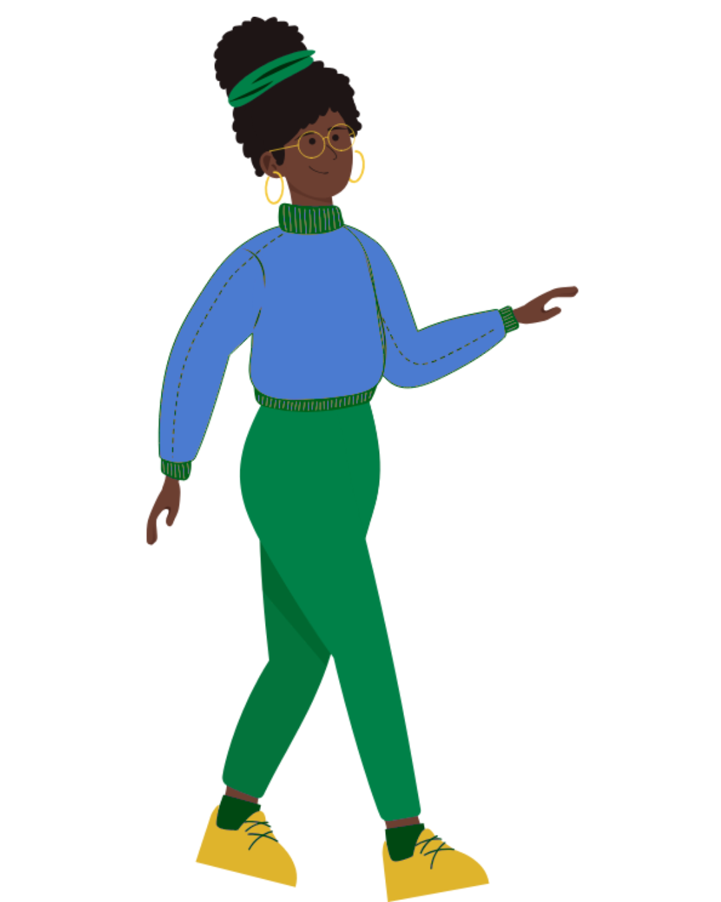
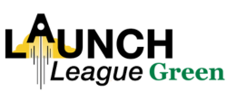
MODULE 2:
Who are my customers and how do I reach them?
Notes:
In this module, we will focus on your customers and how to reach them.

Slide 2

What is Launch League?
This programme material was originally developed by the British High Commision UK-South Africa Tech Hub and Viridian through the Launch League initiative.
Launch League creates material and training/ networking opportunities for South African hubs and training organisations, so that we can better support YOU – promising entrepreneurs from our community!
www.launchleague.co.za
Launch League Green

Slide 3
What is Launch League Green?
Businesses that have environmental sustainability at the heart of their model can not only create significant impact in our communities by solving pressing challenges, but they also have significant potential for growth and job creation due to investment interest and allocation.
Launch League Green is a programme Viridian ran in mid-2025 for entrepreneur support teams to increase their knowledge and networks to run specialised programmes for green entrepreneurs in their communities. This version of the Launch League idea-stage programme uses an example of a green business to inspire entrepreneurs in the green economy!
Launch League Green

Slide 4

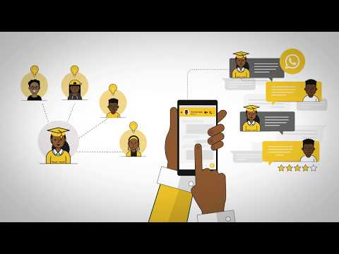
What is the number one difference between customers and users?
Launch League Green
Copyright UK-SA Tech Hub 2020
Notes:
NOTE: this video uses the original Launch League business example, ABC Tutors. It is a relatable example that can still be useful to your entrepreneurs, but take extra care to explain the same concepts using the Launch League Green green economy example, Amazing Briquettes.
https://www.youtube.com/watch?v=H0FOB6czWYY
In this video, we’ll look at the market section of your canvas. At the end of this module, we will be able to fill out the customers and pathways section of your canvas.

Slide 5
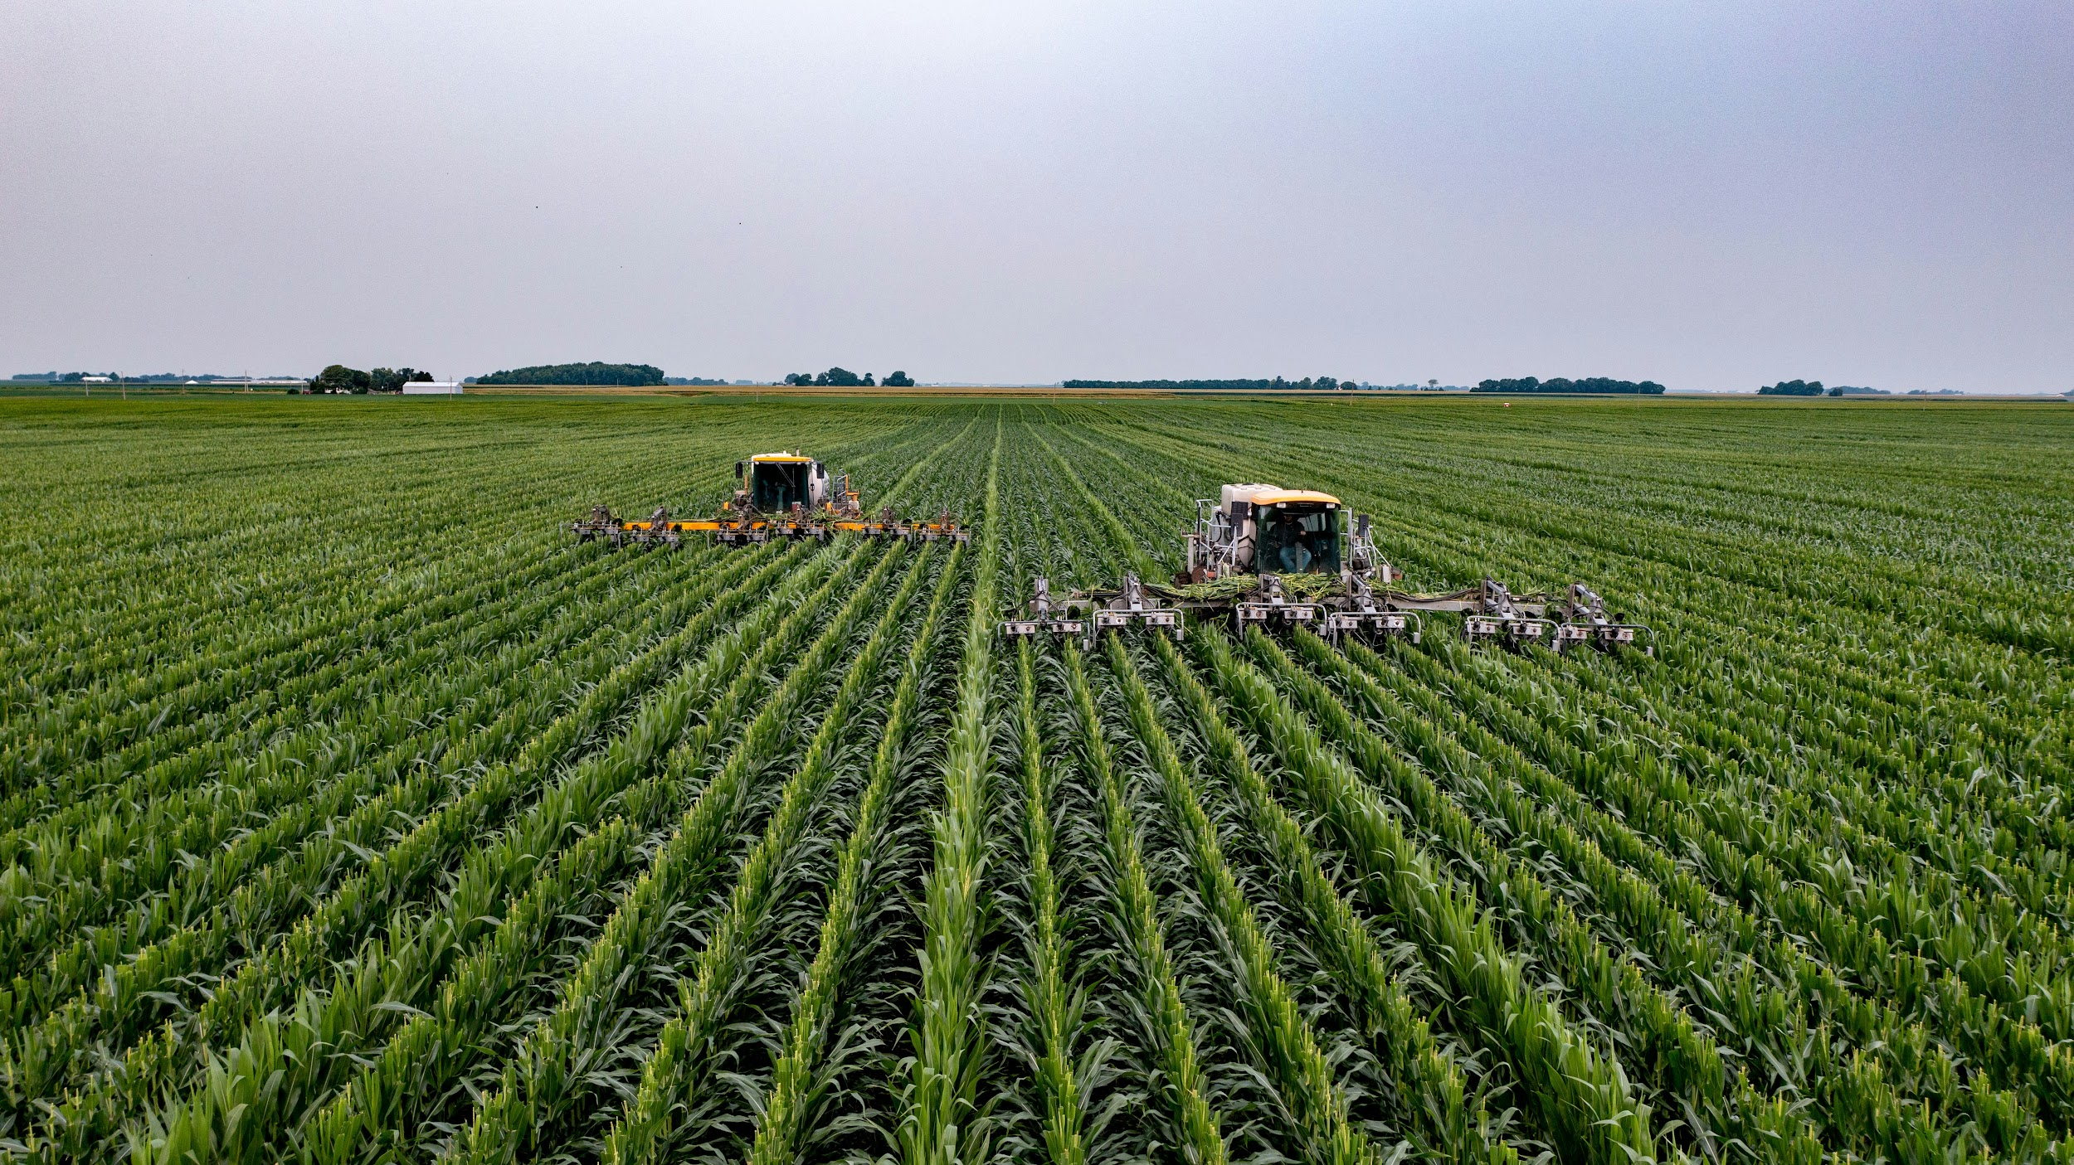
1.
Customers
Launch League Green
Notes:
Your customers are your most valuable asset as a business. All your business decisions should have what is best for your customers in mind.

Slide 6
What is the number one difference between customers and users?
Launch League Green
Notes:
{Question for group -- what is the difference between a user and a customer?}

Slide 7
Pay vs Use
Your customers are the ones who pay you.
If you are a non-profit company, who is your customer?
If you are a B2B company, who is your customer?
Launch League Green
Notes:
Your customers are those who pay for your product or service. The user is the person who actually uses/ benefits from your product or service.
Amaizing Briquettes has customers and users. Its customers are the retailers and other organisations which buy the briquettes. Its users are households and chefs who use them.
{Question for group - For any of your businesses - are your customers different to your users?}

Slide 8
Target customers
While your target market is the group who is most likely to buy your product or service…
Your target customer is the person who is most likely to buy your product or service.
Think about how you would describe your target customer...
Launch League Green
Notes:
When you define your target market -- this is a broad group of people. For instance, South African retailers.
When you define your target customer, however, you will be much more specific. E.g., spaza shops.
{Question for group - Can anyone describe your ideal customer currently?}

Slide 9
Target customers: Amaizing Briquettes
Chain grocery stores which provide space for local business products, such as Spar. These typically service the middle and upper class and would prefer easily traceable electronic payments.
Spaza shops, who may be informal in nature and use informal value chains to source their products. They typically service lower income households and may be more selective about payment methods.
Petrol station shops, which can be part of a chain or independent shops. They tend to service those who can afford cars, but also local communities and truckers. As they are open 24/7, they are likely to prefer using electronic funds for security reasons.
Organisations such as school feeding schemes. These do not create a profit and service the most vulnerable groups. They usually have tight budgets and would favour easily traceable suppliers to make reporting to their sponsors/funders easier.
Launch League Green
Notes:
{Read through characteristics with group}

Slide 10
Adoption
Why would someone buy or use your product or service?
Why would someone not buy or use your product or service?
Launch League Green
Notes:
{Check understanding of adoption}
Adoption is the process by which customers hear about and then start using and paying for your product or service. This can be a challenging process, especially if there are alternatives in the market or existing ways of doing things that people are very comfortable with -- in other words, you may have to convince people to change their behaviour in order to start using your product.
{Question for group - Think of Amaizing Briquettes, turn to the person next to you and discuss why someone would/ would not start using service?} {Allow 2 minutes}

Slide 11
Example: Amaizing Briquettes
Retailers can be given some free briquettes to test for themselves at their home.
Retailers may hear about Amaizing Briquettes if their customers ask about them. (This is called “word of mouth” and works if customers have already had a good experience using the briquettes.)
Retailers may come across online or offline marketing of Amaizing Briquettes, such as Facebook accounts or posters in and around taxis.
Launch League Green

Slide 12
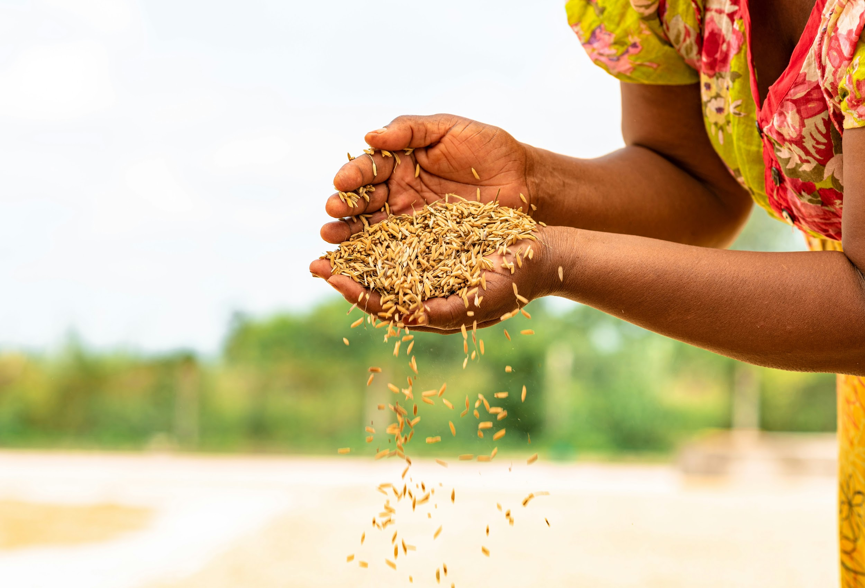
2.
Customer Validation
Launch League Green
Notes:
The second concept we are going to look at in this module is customer validation. You will be doing some deep-dive customer validation after this bootcamp is done, and we will discuss the results in the first meetup.

Slide 13
Customer validation is a process where you gather information and feedback from your customers and the market about their problems as well as your proposed solution.
Launch League Green
Notes:
{Read through the quote/ definition of idea validation}
Now that we understand the problem and solution... what do our potential customers think about the solution? And, do we really understand the problem or are we making assumptions.
{Question for group -Has anyone done some customer validation already? How did you do it?}

Slide 14
Good customer validation allows you to:
Really understand your customer’s need
Confirm or disprove your assumptions about them, their problem and how they currently solve it
Understand what they might pay for your solution
Build a better business or move on to your next idea
Stops you from making unnecessary mistakes, wasting time and resources and money!
Launch League Green
Notes:
Successful entrepreneurs are constantly speaking to their customers and finding ways to get feedback and better understand them.

Slide 15
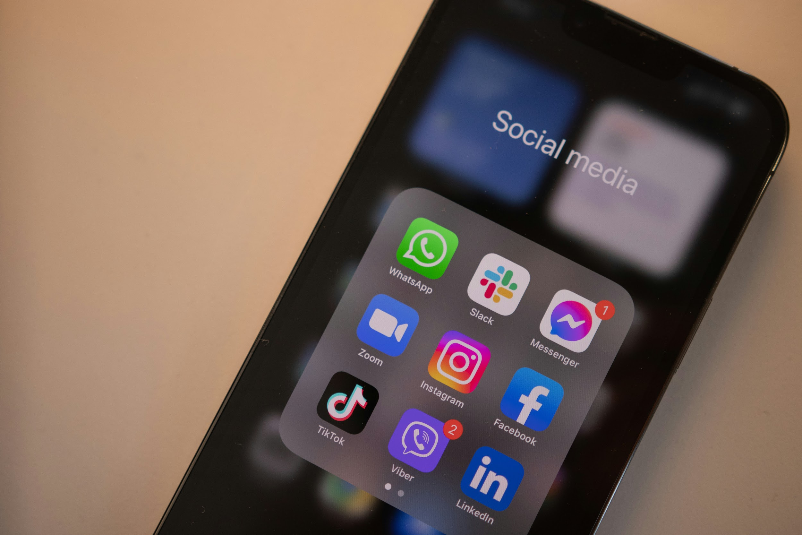
3.
Pathways to your customers
Launch League Green
Notes:
You need to understand how to reach your customers.

Slide 16
Pathways to your customers
There are many different ways to reach your customers and tell them about your product. These are your marketing channels or pathways to customers.
Think about the many ways in which you learn about new businesses or products...
Launch League Green
Notes:
{Check understanding of pathways - ask participants to share some of the ways they’ve discovered new products or services recently. How did you decide to use it? Did you discover it through a friend or online?}
If your business has users and customers (e.g. Amaizing Briquettes, the households/chefs are the users and retailers/organisations are the customers), then you must be sure that you are focussing on how to reach your customers, but you could do this through reaching your users too. E.g., a spaza shop may learn about the briquettes through customers asking if they have Amaizing Briquettes.

Slide 17
What are some of these pathways?
Social Media: Twitter, FaceBook, Instagram, Whatsapp etc.
Word of mouth or referrals
Direct sales
Through a partner business / organisation
Traditional media: TV, Newspaper, Radio
Online advertising (FB or Google ads)
Newsletters & email marketing
Billboards, posters & flyers
Website listings
Launch League Green
Notes:
{Go through the channels and ensure all are considered}
These are also often called your marketing channels. These are the ways in which you reach your customers. You will usually use a mix of pathways. Depending on your customer profile, different channels will work better for different audiences. You can discover what pathways to use for your business during customer validation, when you start to better understand your customers. Again, you should be sure not to make assumptions about your customers. E.g. don’t assume that everyone uses Facebook or will see posters.

Slide 18
Once your customer has learnt about your product or service…
Where do they get it?
And how do they pay for it?
Launch League Green
Notes:
Once you’ve reached your customers through your pathways:
Where do they get it... is it better for your customer to have it delivered to them, or would they prefer to collect? Would they collect straight to you pick up from you, or at another local business or shop that they go to? Does the customer need to download it? What is a credible way for you to send them the link and have you considered the data implications for the end user? If you’re providing services, how does a customer book your time?
How they pay for it... Does your customer feel comfortable or prefer to pay online? Do they use a lot of cash and prefer cash? Would they prefer to pay through a machine in-person?

Slide 19
What pathways would be best for your customers?
It’s important for you to use the right pathways for your customers, and to get your product to them.
Choose which ones are right for your customers and business!
Launch League Green
Notes:
Which channels you choose, depends on the age/ income/ digital savviness of your customers.
{Question for group - which channels do you think will work best for Amaizing Briquettes for reaching their customers?}

Slide 20
Example: Amaizing Briquettes
Amaizing Briquettes uses a number of channels or pathways to reach retailers, which are their primary target market.
Talking about the benefits of the product on free social media platforms, especially Facebook, Twitter, and Instagram - paid ads if there is budget for it.
Setting up meetings with store owners and school principals / feeding scheme NGO heads to discuss how they can work together.
Negotiate discount packages with wholesalers that supply spaze shops.
Advertising on and in taxis, as well as posters in train stations and taxi ranks – it's likely that your target audience will use these to travel.
Launch League Green
Notes:
{Read through example}

Slide 21

Your turn!
Launch League Green
Notes:
We are now going to look at your target customer and also your customer pathways.
Please take out Module 2 exercise 1 and 2 from your pack.}

Slide 22
Target Customer
Complete Target Customer worksheet, thinking about your business’ ideal customer. (10 minutes)
Discuss your Target Customer with a partner. (10 minutes)
Launch League Green
Notes:
Let’s start with your Target Customer. Please complete the worksheet, we will then discuss.
{20 minutes}

Slide 23
Pathways to your customers
Complete Customer Pathways worksheet, unpacking the best pathways to reach your target customer. (10 minutes)
Discuss your Pathways with a partner (10 minutes).
Add your Pathways to your canvas.
Launch League Green
Notes:
Next, your Customer Pathways worksheet. Please complete the worksheet, we will then discuss.

Slide 24
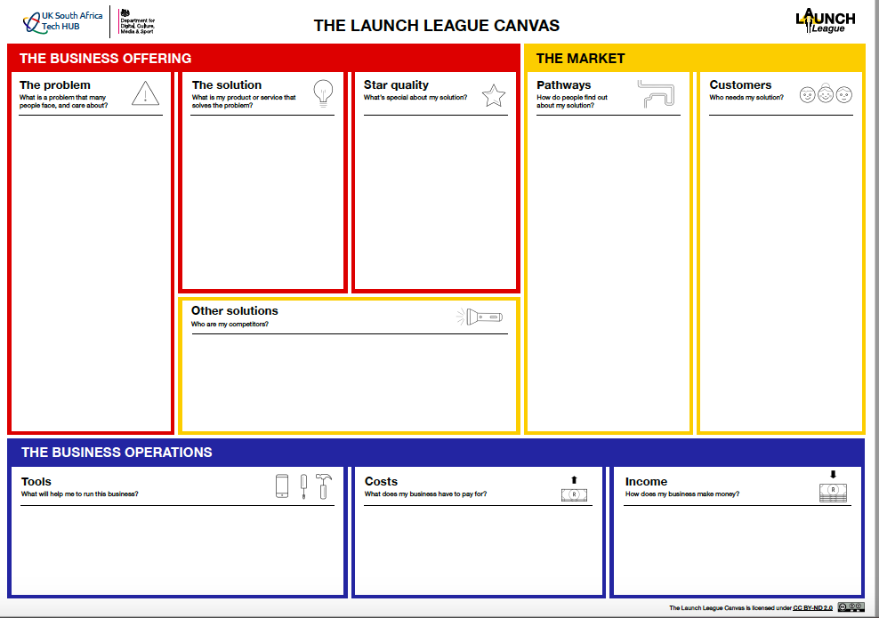
Many SA households and organisations use or rely on burning coal, wood, perofene, or gas to cook.
These are unhealthy, unsustainable, and set to become less affordable.
The existing alternative are typically pricy, such as eco-friendly briquettes at high-end grocery stores.
Meanwhile, maize crops create a lot of unused waste which can be turned into briquettes.
Amaizing Briquettes sources maize waste from 15 local farmers, processes it into briquettes, and then sells it to retailers and a local school feeding scheme.
Free social media platforms, especially Facebook, Twitter, and Instagram.
Setting up meetings with store owners & school principals to discuss how they can work together.
Advertising on and in taxis, as well as posters in train stations and taxi ranks - it's likely that your target audience will use these to travel and will be stuck in queues.
Retailers, such as spaza shops, grocery stores, and petrol station shops. All located in or around Mbombela.
Organisations such as school feeding schemes who service vulnerable groups. All located in or around Mbombela.
Users: Households and chefs of various income groups, through primarily those who want affordable, healthy briquettes.
Amaizing Briquettes
Notes:
{Amaizing Briquettes Example}

Slide 25
Notes:
Once you are happy with your target customer and pathways, you can add to your canvas.

Slide 26
2
1
i

Slide 27
Who are my customers and how do I reach them?
Launch League Green

