Slide 1


MODULE 5:
What do I need to run my business?
Notes:
Welcome to the final module of the bootcamp and the final block on your Launch League canvas!

Slide 2

What is Launch League?
This programme material was originally developed by the British High Commision UK-South Africa Tech Hub and Viridian through the Launch League initiative.
Launch League creates material, and training and networking opportunities for South African hubs and entrepreneur support organisations, so that we can better support YOU – promising entrepreneurs from our community!
www.launchleague.co.za
Launch League Green

Slide 3
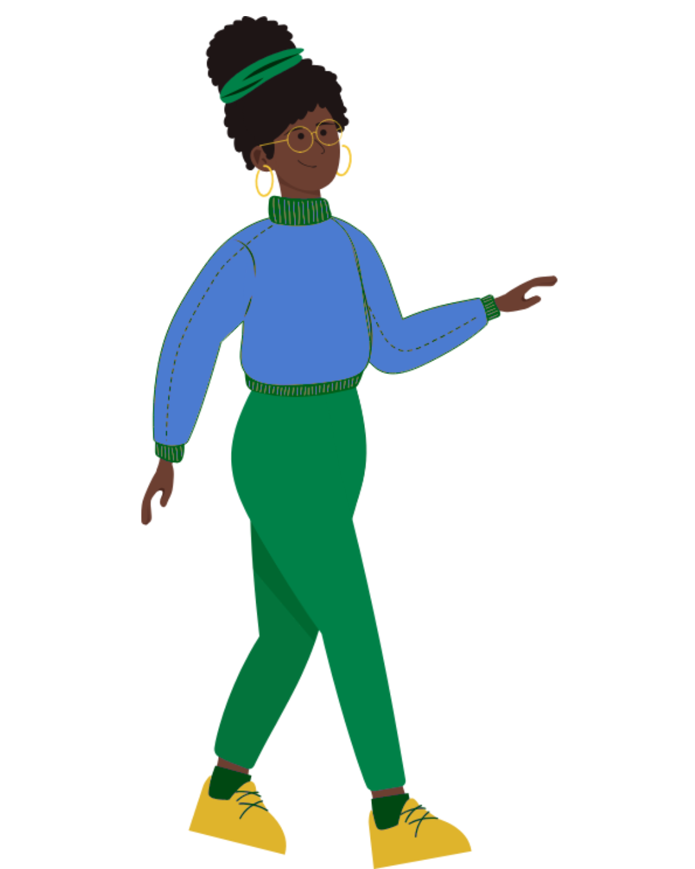
What is Launch League Green?
Businesses that have environmental sustainability at the heart of their model can not only create significant impact in our communities by solving pressing challenges, but they also have significant potential for growth and job creation due to investment interest and allocation.
Launch League Green is a programme Viridian ran in mid-2025 for entrepreneur support teams to increase their knowledge and networks to run specialised programmes for green entrepreneurs in their communities. This version of the Launch League idea-stage programme uses an example of a green business to inspire entrepreneurs in the green economy!
Launch League Green

Slide 4


1.
Tools & resources
Launch League Green

Slide 5
It is almost impossible to build a business on your own. You will need tools, resources and partners to make your business a success.
Launch League Green
Notes:
While it is important as an entrepreneur to be independent and resilient, it’s also important to realise that your business will grow stronger together with others. Better tools and systems, making good use of resources like skilled staff members and financing, and building partnerships to expand your offering or bring down costs are all important aspects of business growth.

Slide 6
Think about the activities in your business and how you want to run or grow your business.
What resources do you need to do this?
What tools could you use to do this?
What partnerships would you like to do this?
Launch League Green
Notes:
Take a moment to think about your business and what it needs. [Read out the questions on the slide.]

Slide 7


Resources
A resource is a stock or supply of money, material, you as the entrepreneur, staff and other assets.
Resources are used by a business when needed, to perform the activities of the business.
Launch League Green
Notes:
Just to clarify… [Read the definition on the slide.]

Slide 8


Tools
A tool is device or object that is used to make something or accomplish a task.
A tool can be a physical device like a piece of equipment, smartphone or laptop, or digital, for example a spreadsheet template, website or piece of software.
Launch League Green
Notes:
Tools are different… [read the definition on the slide]

Slide 9
Tools & resources
Tools and resources can take various forms, and while some might be paid, many are free. These can be:
Digital or online
Physical
Paid for or free or in-kind
Shared or owned
Protected or secret
Networks or communities
It’s now cheaper to start and grow a business than ever before, because there are so many free tools and resources available.
Launch League Green
Notes:
There are many different types of tools and resources…
[Read the bullet points on the slide]
We will take time to think through ones you can use in the exercise at the end of the module. The good news is, many of these tools and resources are free, and you may already have access to more of them than you think!

Slide 10
Let’s revisit our example….
Amaizing Briquettes uses a variety of tools, resources, and partnerships for their business.
Tools: They rely on digital tools like WhatsApp and Facebook to communicate to both suppliers and customers. They use EFT to pay suppliers and Yoco to accept payments.
Resources: They rely on maize farmers who provide maize waste for them to process into briquettes. They also require packaging for the bags and a bakkie to transport their briquettes.
Launch League Green
Notes:
[Read the slide]

Slide 11


Partnerships
A partnership is often a formal relationship where two or more people or businesses work together for mutual benefit.
Parties are active participants and co-operate, sharing resources, information income, and responsibilities.
Launch League Green
Notes:
Now, let’s talk about partnerships…
[Read the definition on the slide]
Some entrepreneurs are nervous about partnerships, but the truth is that if you start and manage them properly, partnerships can be an important growth engine for your business.

Slide 12




Partnerships that work for Amaizing Briquettes….
Local municipality wants to donate recycled packaging as part of a circular economy project.
A local conservation NGO who want to stop deforestation wants to offer support via digital tools.
The Department of Agriculture, Land Reform and Rural Development would like to subsidise transportation costs to help the business make a profit.
University of Mpumalanga has researchers who would like to help make the manufacturing process more efficient in exchange for information on how this works in practice.
Launch League Green
Notes:
[Talk through the partnerships]

Slide 13
You can map the resources, tools and partnerships you already have, and would like to have, in your business.
Business Function | Resources | Tools | Partnerships
Producing your product or service
Pathways to customers
Distributing to customers or users
Collecting payments & managing costs
Keeping the operations on track
Remember you don’t always need all three for every area of your business!
Launch League Green
Notes:
You may use different tools, resources and partnerships in different aspects of your business.
We’ll be using this table in your exercise later: remember, you don’t always need to have all three in every area of your business, but it is worth thinking about.

Slide 14
Let’s look at Amaizing Briquettes again...
Business Function | Resources | Tools | Partnerships
Producing your product or service | Maize waste, packaging | Briquette compactor | UMP researchers, local municipality
Pathways to customers | Posters, Instagram and Facebook posts | Canva, other digital tools | Local conservation NGO
Distributing to customers or users | Bakkie and petrol | WhatsApp and Google Maps | Department of Agriculture, Land Reform and Rural Development
Collecting payments & managing costs | Cash flow | Text to Pay, Snapscan, Yoco, and EFT
Keeping the operations on track | Skilled employees | Google Drive & Docs, WhatsApp | UMP researchers
Launch League Green
Notes:
Let’s look at Amaizing Briquettes again… [Pick out examples from the table, ask participants if they have any questions, and address them or get the group to help.]

Slide 15
But, one of the most important resources in your business is YOU!
Launch League Green
Notes:
[Read the slide.]

Slide 16
2.
You the entrepreneur
Launch League Green
Notes:
It’s important to understand yourself and the unique qualities and strengths you bring to your business. So, let’s talk about you!

Slide 17
Entrepreneurial characteristics
There isn’t one type of entrepreneur but most successful entrepreneurs have the following characteristics:
Passion
Risk-taking
Flexibility
Self-confidence
Management skills
Networking skills
Financial management skills
Grit or Resilience
Launch League Green
Notes:
Would you describe your personality and skills using at least three of the following words?
[Read the bullets slowly - look at the audience and nod while doing so - let them absorb!]
Passion: Having the energy to maintain your belief in your product or service and business through the ups and downs is essential. Passion also makes you persuasive to clients and partners.
Risk-taking: By understanding risks and taking them, the entrepreneur sets themselves apart from most people, who are do not have the risk appetite to grab the opportunity.
Flexibility: An entrepreneur guides their business to adapt to a changing environment and what their customers want.
Self-confidence: An entrepreneur believes in themselves -- this is not about having a big ego, but in believing in your ability to deliver the goods or make a plan.
Management skills: In a growing business there are a lot of tasks happening all at once -- juggling these successfully (and delegating them, where possible) is the job of an entrepreneur.
Networking skills: Connecting with people and adding value to others means the entrepreneur always has their network to draw on.
Financial management skills: Bringing in money, managing expenses and planning around cash flow are all critical to an entrepreneur’s success.
Grit / Resilience: Entrepreneurs chase opportunities and keep going when things are tough.

Slide 18
Entrepreneurial Types
There are a number of different entrepreneurial archetypes which you might identify with:
Innovators
Hustlers
Imitators
Researchers
You could be a combination of a number of these! Let’s look at them further.
Launch League Green
Notes:
Often entrepreneurs will be stronger on some of the characteristics we’ve discussed than others.
In this way, there are are many types of entrepreneur in reality.
We’re going to discuss four: do you identify with one or two of the descriptions more than others?
By understanding how you prefer to work as an entrepreneur you can be more effective in building your business.

Slide 19
The Innovator
Come up with completely new ideas & turn them into new businesses
Extremely passionate and can be obsessive
High Risk takers, as they embrace fear & the unknown
Look for patterns
Obsessive note takers
Aim for perfection, but doesn’t let it get in the way of delivery
Launch League Green
Notes:
[read slide]
Examples: Bill Gates, Larry Page

Slide 20
The Hustler
Hard workers focusing on the opportunity and get their hands dirty
Start small but think big
Very focused
Know the importance of networking
Risk takers, as they embrace fear & the unknown
Launch League Green
Notes:
[read slide]
Example: Richard Branson

Slide 21
The Imitator
Take a business model or something that is successful and change it slightly
Do their research
High self-confidence
Risk takers
Launch League Green
Notes:
[read slide]
Examples: Mark Zuckerberg

Slide 22
The Researcher
Even after having an idea, researchers will take their time to gather all the relevant information about it.
Problem solvers
Do research to limit risk
Good management skills
Launch League Green
Notes:
[read slide]
Examples: Jeff Bezos

Slide 23
Your team
As you grow your business it’s important that you know what your strengths are and what your weaknesses are.
It’s important that when you look for a co-founder in your business or partner, or even team members, that you choose people who have complimentary skills to you.
We can’t be perfect at everything, so rather build a diverse team to ensure that you have a balance of all the characteristics!
Launch League Green

Slide 24

Your turn!
Launch League Green
Notes:
We are going to brainstorm tools, resources and partnerships, and then close off with an exercise about your most valuable resource -- yourself!

Slide 25
Tools & resources
Using the tools and resources worksheet, look at the tools resources and partnerships that you have in your business.
Think about what partnerships your might need in the future too.
Once you have a first version, discuss this with someone else in the programme.
Once you understand the essential tools for your business, complete the last section in your canvas -- tools!
Launch League Green

Slide 26
You as an entrepreneur
Using the entrepreneurial characteristics worksheet, describe your main entrepreneurial characteristics and which entrepreneurial type you identify with. Think about the type of person you might need in your business to compliment you.
Use the time to right a brief bio for yourself as an entrepreneur.
Once you have a first version, test it by reading it out to someone. Ask them if they have any suggestions to how you could improve your profile.
Launch League Green

Slide 27
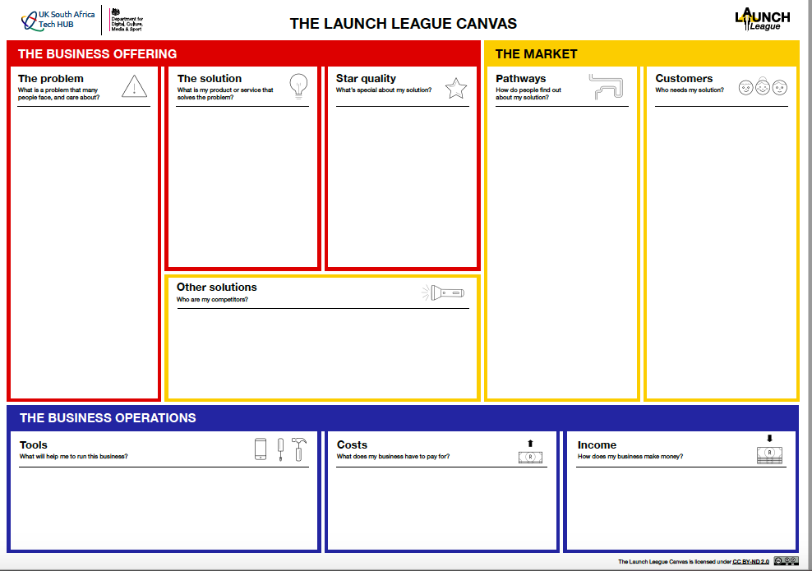
Many SA households and organisations use or rely on burning coal, wood, perofene, or gas to cook.
These are unhealthy, unsustainable, and set to become less affordable.
The existing alternative are typically pricy, such as eco-friendly briquettes at high-end grocery stores.
Meanwhile, maize crops create a lot of unused waste which can be turned into briquettes.
Amaizing Briquettes sources maize waste from 15 local farmers, processes it into briquettes, and then sells it to retailers and a local school feeding scheme.
Sourcing maize waste allows the business to create affordable briquettes.
It is better for the health of households and chefs, which people value due to the prevalence of respiratory problems in South Africa.
Free social media platforms, especially Facebook, Twitter, and Instagram.
Setting up meetings with store owners & school principals to discuss how they can work together.
Advertising on and in taxis, as well as posters in train stations and taxi ranks - it's likely that your target audience will use these to travel and will be stuck in queues.
Retailers, such as spaza shops, grocery stores, and petrol station shops. All located in or around Mbombela.
Organisations such as school feeding schemes who service vulnerable groups. All located in or around Mbombela.
Users: Households and chefs of various income groups, through primarily those who want affordable, healthy briquettes.
Amaizing Briquettes
Direct competitors are either unsustainable/ unhealthy or expensive.
Substitutes or indirect competitors include electricity services, though these are currently expected to become more expensive and less accessible.
Online tools: WhatsApp, Facebook, Instagram…
Resources: maize waste, packaging, petrol…
Partnerships: municipality, national government departments, NGOs, universities…
Cost of sales include sourcing maize waste, processing it, and packaging it.
Overhead costs include salaries, insurance, travel expenses...
Income is generated through selling bags of briquettes to customers.
Notes:
{ABC Example}

Slide 28
Notes:
Once you’ve completed your tools, resources and partnerships table, you can fill in the ‘Tools’ block in your ‘Business Operations’ section of the Launch League Canvas.

Slide 29
5
4
3
tt
2
1
i
Notes:
Well done! Your canvas is complete!
After the break, we’ll share a few more tech tools with you that you will find useful on your business journey.
That will land you on the moon, and you’ll officially be a member of the Launch League for life!
Enjoy your tea.

Slide 30
MODULE 5:
What do I need to run my business?
Launch League Green

